Slide 1
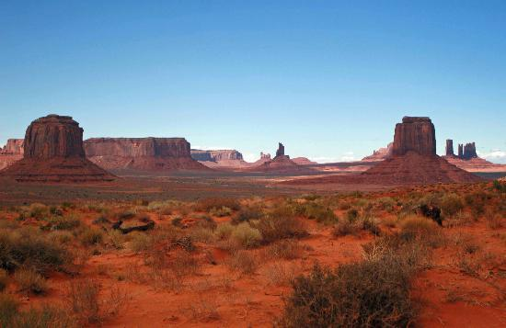
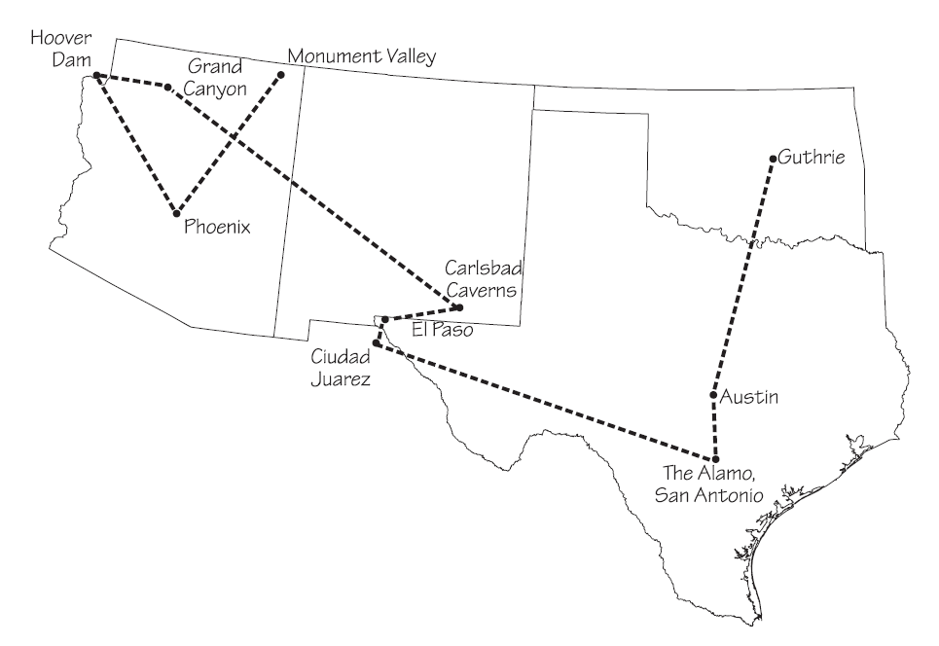
A Big Rig
Tour of the Southwest
PowerPoint presentation by Mrs. LeFave & Mrs. Daniels
Notes:
Background image retrieved on 1/29/2012 from http://ed101.bu.edu/StudentDoc/current/ED101fa10/hillaryw/Images/southwest_landscape.jpg

Slide 2
Southwest Region Tour
Stop 1: Monument Valley: Home of the Navajos
Stop 2: Phoenix, Arizona: America’s Hottest City
Stop 3: Hoover Dam: A Concrete Marvel
Stop 4: The Grand Canyon: Arizona’s World-Famous Wonder
Stop 5: Carlsbad Caverns: Big Rooms and Bats in New Mexico
Stop 6: El Paso & Ciudad Juarez: Two Cities, Two Countries, One Border
Stop 7: San Antonio, Texas: Home of the Alamo
Stop 8: Austin: The Capital of Texas
Stop 9: Guthrie, Oklahoma: Center of the Land Rush
Notes:
Text from stops audio files retrieved 3/2/2012 from http://sas-origin.OnstreamMedia.com/origin/tci/public/4_ROC

Slide 3
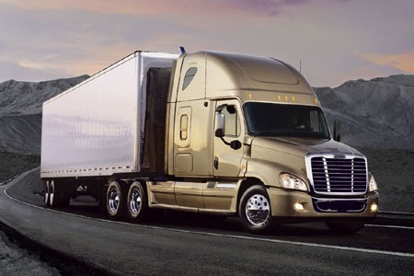

Traveling by Big Rig
During our tour of the Southwest Region, we will travel in big rigs (large trucks also known as mack trucks or 18-wheelers). Big rigs drive all over the country bringing goods from one place to another.
Essential Question
How have geography and history shaped life in the Southwest?
Notes:
Big rig image retrieved 3/2/2012 from http://www.autoblog.com/2007/05/09/freighliner-announces-new-big-rig-the-cascadia/
Big rig wav files retrieved 3/2/2012 from http://www.autospeak.com/library.htm

Slide 4
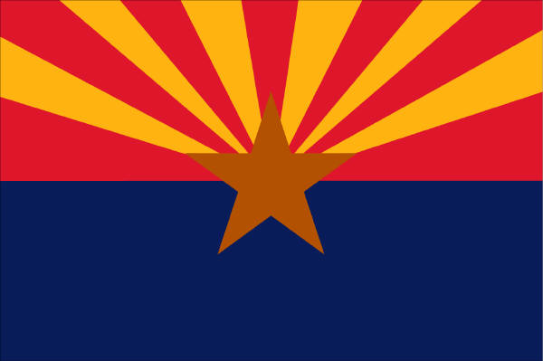
Welcome to Arizona!
State Date: February 14, 1912
Nickname: Grand Canyon State
Motto: God Enriches
Capital: Phoenix
Flower: Blossom of the Saguaro Cactus
Bird: Cactus Wren
Tree: Palo Verde
Song: Arizona

Slide 5
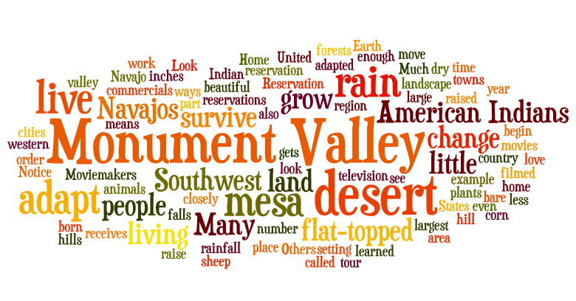
The first stop we will travel to is Monument Valley…

Slide 6
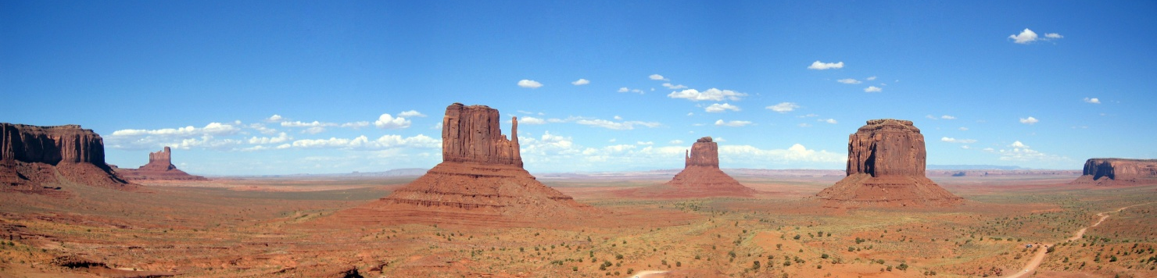
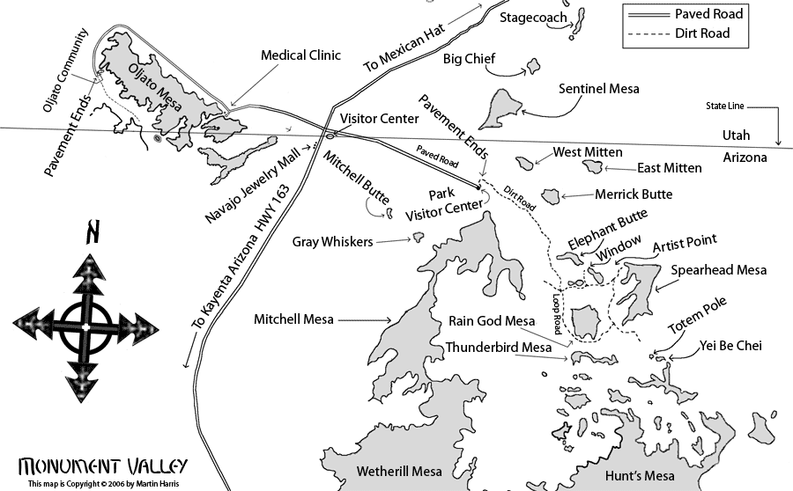
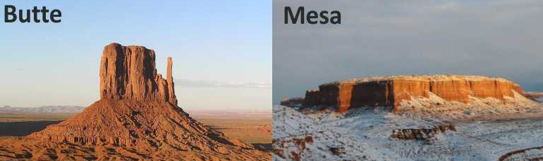
Stop 1: Monument Valley:
Home of the Navajos
Monument Valley is within the Navajo Nation Reservation, the largest reservation in the country. Many places in Monument Valley can only be reached on tours led by Navajo guides. The monuments have descriptive names such as Rain God Mesa, Elephant Butte, and Totem Pole.
Fun Fact: A butte is taller than it is wide. A mesa is wider than it is tall.
Notes:
Navajo name Tsé Biiʼ Ndzisgaii meaning valley of the rocks, part of Colorado Plateau, buttes are up to 1000 ft tall
mesa / butte (long u sound): flat-topped hill
Image retrieved 4/15/12 from http://en.wikipedia.org/wiki/File:Monumentvalley.jpg
Map retrieved 4/15/12 from http://www.firetreeinn.com/mapmvw.html
Butte vs Mesa image retrieved 4/16/12 from http://www.geocaching.com/seek/cache_details.aspx?guid=2a8793ac-4589-4255-b540-6cc5c5d54982

Slide 7

Stop 1: Monument Valley:
Home of the Navajos
Monument Valley tour video (2:04)
Notes:
Tour video retrieved 4/16/12 from http://www.youtube.com/watch?v=1ASjP9IGrnM (2:04)

Slide 8
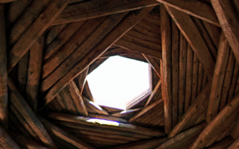
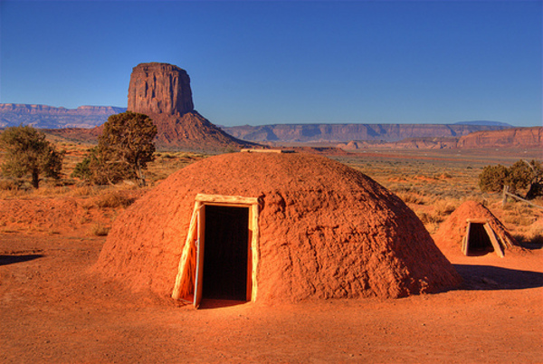
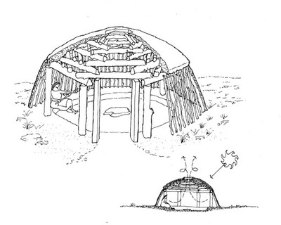
Stop 1: Monument Valley:
Home of the Navajos
The traditional Navajo home is called a hogan. They are usually round, cone-shaped, and made of wood and packed mud. There is a hole in the top so that smoke can get out. The door of a hogan faces east to welcome the rising sun and for good luck.
Notes:
hogan: traditional Navajo home
‘male’ hogan with vestibule only used for ceremonies, larger ‘female’ hogan used as a home
Hogan no longer is used if someone dies in it, lightning strikes near it, or bear rubs against it
Hogan image retrieved 4/16/12 from http://www.weblo.com/property/city/Navajo/78611/
Hogan ceiling image retrieved 4/16/12 from http://virtualguidebooks.com/Arizona/NorthernArizona/WindowRock/WindowRock.php
Hogan diagram retrieved 4/16/12 from http://ocw.nd.edu/architecture/nature-and-the-built-environment/lecture-2/l2-typ-navajo-hogan/image_view_fullscreen

Slide 9

Stop 1: Monument Valley:
Home of the Navajos
Monument Valley from sunrise to moonrise video (4:27)
Notes:
Sunrise to moonrise video retrieved 4/16/12 from http://www.youtube.com/watch?v=ryqdoe6xLs4 (4:27)

Slide 10
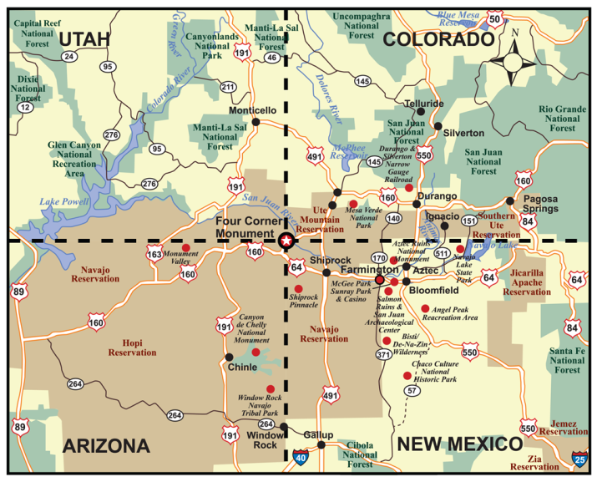
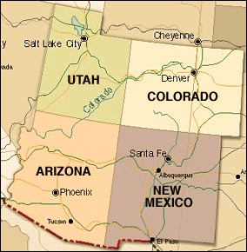
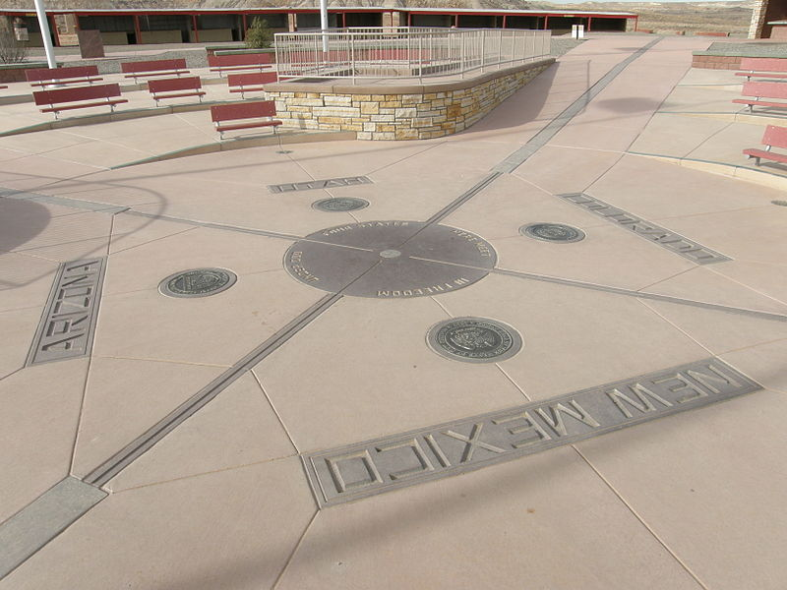
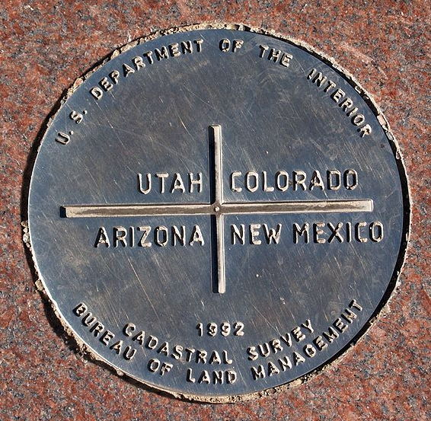
Four Corners
Monument Valley is located near the Four Corners area. The Four Corners is the spot where the borders of Utah, Colorado, Arizona, and New Mexico meet. The spot was first marked in 1912, and a bronze marker was placed in 1931.
Notes:
Only place in the United States where four states borders meet. Location was established in 1861 as the southwest corner of the Colorado Territory. Monument was completely rebuilt in 1992, and in 2010. Can stand/sit on the marker.
Four Corners marker & monument images retrieved 4/15/12 from http://en.wikipedia.org/wiki/Four_Corners_Monument
Overview map retrieved 4/15/12 from http://www.sevendirections.net/english/southwest/Southwest_overview.html
Detail map retrieved 4/15/12 from http://www.saintjohnschurch.info/aboutsaintjohns.php

Slide 11
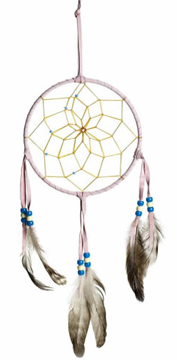

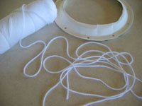
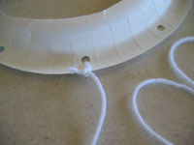
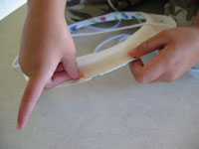
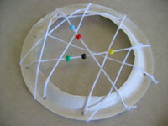
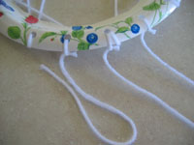


Activity: Make a Navajo
Dream Catcher
Instructions:
Tie one end of a piece of yarn 5-6 feet long to any one of the holes on the rim of the paper plate.
Weave the yarn up, over, and all around the paper plate from one hole to the next one. You can make your pattern any way you like. Make sure to loop through each of the punched holes.
You can add the craft beads to the middle of the dream catcher with the yarn as you go through the holes. Simply slip them onto the yarn and continue with the next hole. They will appear to be in the middle of the dream catcher.
Once all of the holes are threaded with the yarn, tie a knot at the end of the yarn with the plate and the last hole.
Take 3 pieces of yarn about 5 inches long each and tie them to the 3 punched holes at the bottom of the dream catcher.
Choose some beads to thread onto each of the 3 yarn pieces and then tie one feather to the end each of the hanging yarn pieces.
Tie a piece of yarn to the hole at the top of your paper plate dream catcher.
Notes:
Dream catcher instructions retrieved 4/21/12 from http://www.dream-catchers.org/make-dream-catchers-kids.php

Slide 12
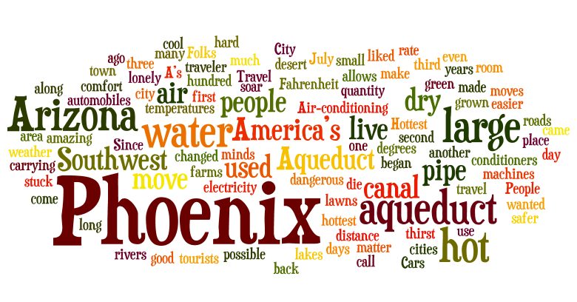
The next stop we will travel to is Phoenix, Arizona…

Slide 13
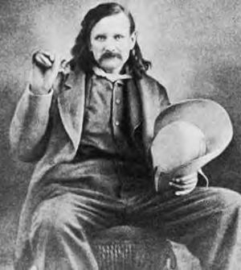
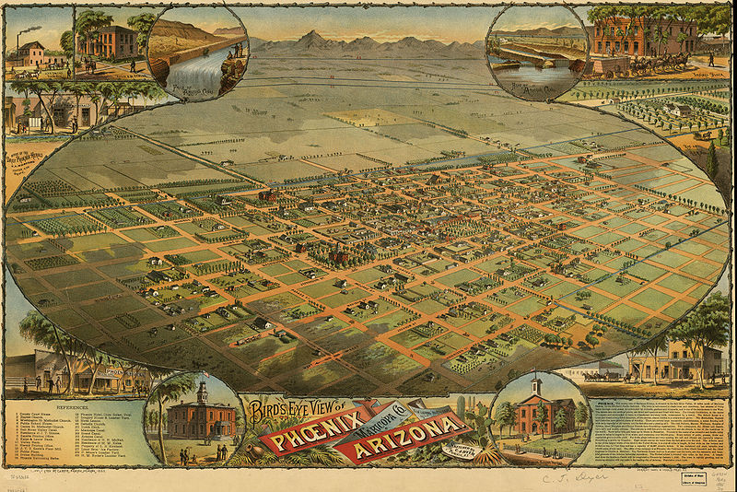
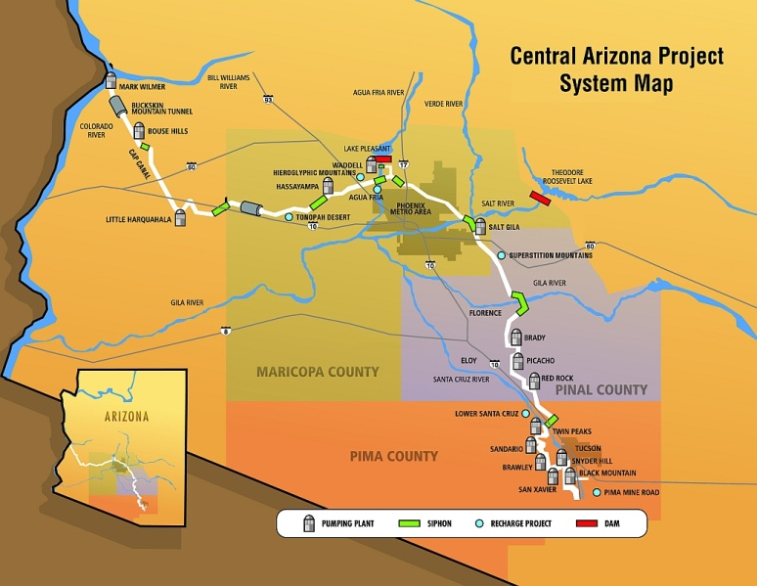
Stop 2: Phoenix, Arizona:
America’s Hottest City
Phoenix was founded by Jack Swilling, a veteran of the American Civil War, in 1867. He built canals that followed those of an ancient Native American irrigation system. It is the hottest large city in the country, and the largest state capital in the United States.
The Central Arizona Project (CAP) system of aqueducts also follows the older canals, and is the largest and most expensive aqueduct system ever built in the United States. The 336 miles of aqueducts, tunnels, pumping plants, and pipelines were begun in 1973 and are still not completely finished.
Notes:
irrigation: adding water to land so crops will grow
aqueduct: a pipe or canal for carrying a large quantity of water from one place to another
Jack Swilling image retrieved 4/16/12 from http://en.wikipedia.org/wiki/Jack_Swilling
Aerial view of Phoenix (1885) retrieved 4/16/12 from http://en.wikipedia.org/wiki/File:Phoenix1885-AerialMap_HiRes.jpg
CAP map retrieved 4/16/12 from http://www.cap-az.com/Portals/1/Skins/cap/images/main-map-large.jpg

Slide 14

Stop 2: Phoenix, Arizona:
America’s Hottest City
Central Arizona Project (CAP) video (1:51)
Notes:
CAP video retrieved 4/16/12 from http://www.youtube.com/watch?NR=1&v=yl43kxHQuo8 (1:51)

Slide 15
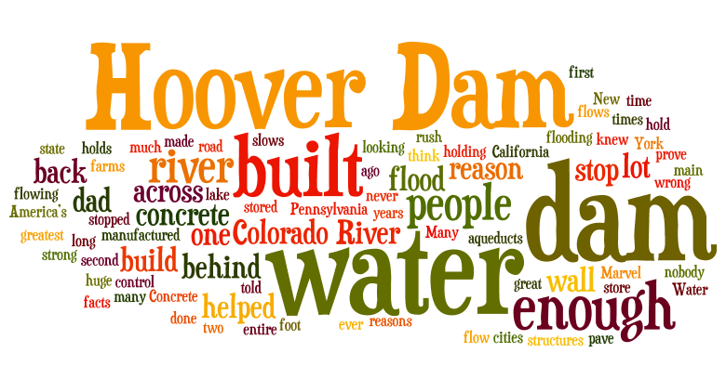
The next stop we will travel to is Hoover Dam…

Slide 16
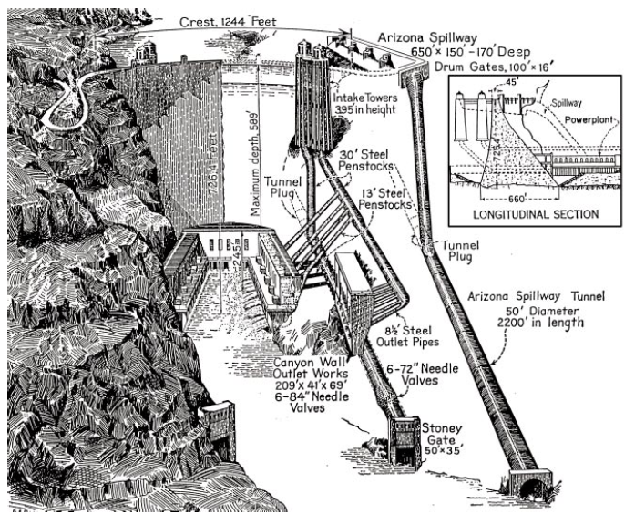
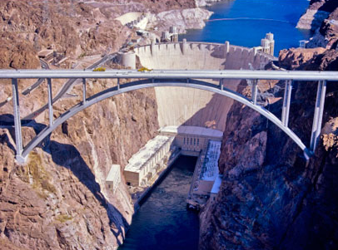
Stop 3: Hoover Dam:
A Concrete Marvel
The Hoover Dam was built between 1931 and 1935 during the Great Depression. The dam is used to control flooding, store water, and produce hydroelectric power. The electricity it generates provide power to Arizona, Nevada, and California.
Fun Fact: Lake Mead is the largest reservoir in the country and has enough water to flood the whole state of New York with 1 foot of water.
Notes:
dam: a wall built across a river to stop the flow of water
hydroelectric power: electricity made by moving water
Colorado River diverted through tunnels while dam being built.
Hoover Dam image retrieved 4/16/12 from http://www.desertusa.com/mag09/dec09/hoover-dam-bridge.html
Diagrams retrieved 4/16/12 from http://www.usbr.gov/lc/hooverdam/educate/hoovered.pdf
Fun fact retrieved 4/16/12 from http://www.usbr.gov/lc/hooverdam/educate/kidfacts.html

Slide 17
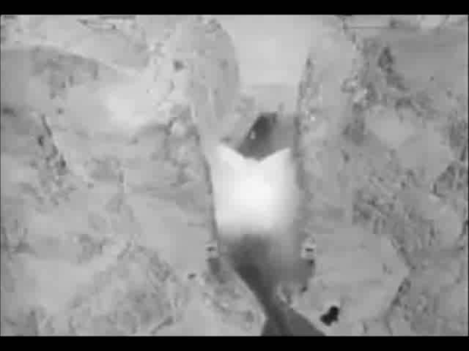
Stop 3: Hoover Dam:
A Concrete Marvel
Hoover Dam construction video (2:00)
Notes:
Exterior video retrieved 4/16/12 from http://www.youtube.com/watch?v=BoJ7X2CQfQI (1:32)
Creation time lapse video retrieved 4/16/12 from http://www.youtube.com/watch?v=GCi4-Lj-3j8 (0:31)
Video merged with Windows Movie Maker

Slide 18
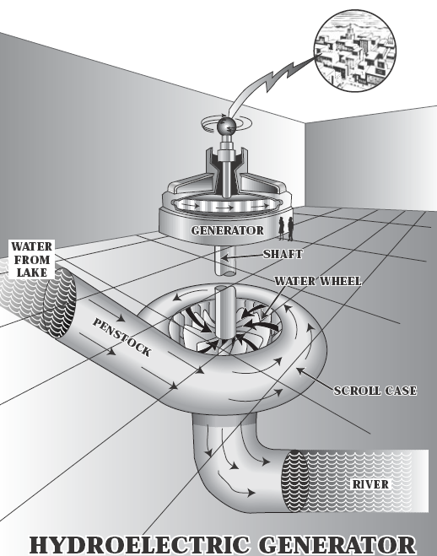

Stop 3: Hoover Dam:
A Concrete Marvel
Fun Facts: Every state provided supplies or materials for the construction of the dam.
There is enough concrete in the dam to build a 4 foot wide sidewalk around the Earth at the Equator.
Inside Hoover Dam video (5:47)
Notes:
Interior video retrieved 4/16/12 from http://www.youtube.com/watch?v=JRsMm8AFafg (5:47)
Fun facts retrieved 4/16/12 from http://www.usbr.gov/lc/hooverdam/educate/kidfacts.html
Diagrams retrieved 4/16/12 from http://www.usbr.gov/lc/hooverdam/educate/hoovered.pdf

Slide 19
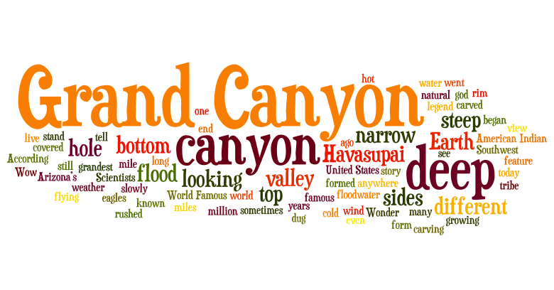
The next stop we will travel to is The Grand Canyon, Arizona…
Notes:
National Parks Service Grand Canyon web site - http://www.nps.gov/grca

Slide 20
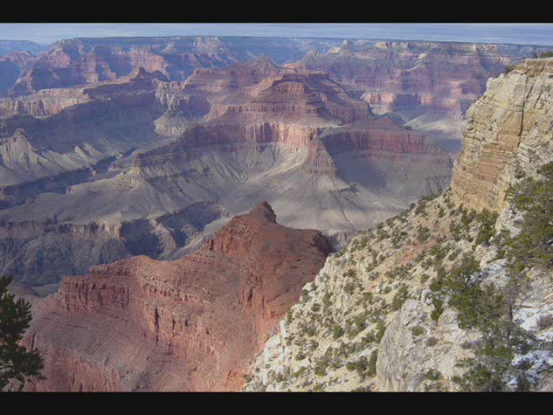
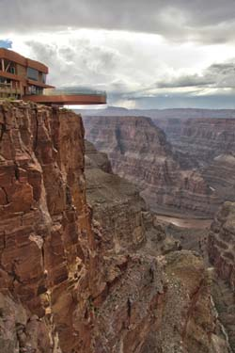
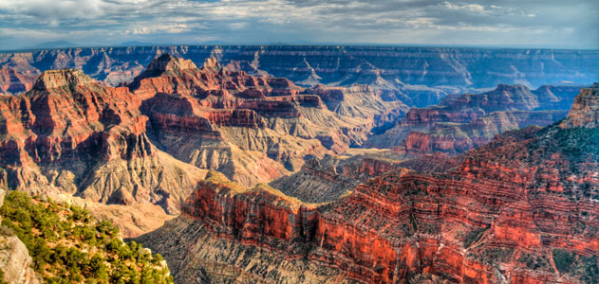
Stop 4: The Grand Canyon:
Arizona’s World-Famous Wonder
Fun Fact:
The Grand Canyon Skywalk is 4000 feet above the bottom of the canyon.
Grand Canyon formation video (3:51)
The Grand Canyon was carved out over millions of years by water eroding the rock to form a canyon.
Notes:
erode: wear away
canyon: a deep, narrow valley with steep sides
The Skywalk is managed by the Hualapai tribe and opened in 2007. Skywalk glass is 2.5” thick, and strong enough to support 71 fully loaded Boeing 747 airplanes (71 million pounds).
Image retrieved 4/16/12 from http://www.smithsonianmag.com/travel/lifelist-grand-canyon.html#
DUDE canyon formation video retrieved 4/16/12 from http://www.nps.gov/grca/photosmultimedia/rm_dude200903.htm

Slide 21
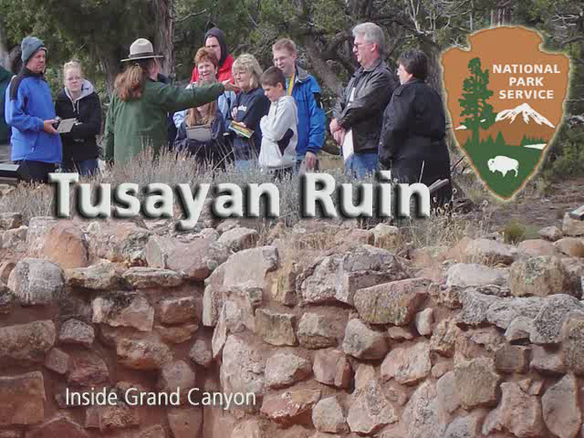
Stop 4: The Grand Canyon:
Arizona’s World-Famous Wonder
The Ancient Pueblo People were the first to live in the Grand Canyon area. They lived at the Tusayan Pueblo in the Grand Canyon about 800 years ago. The Hopi tribe is descended from the Ancient Puebloans.
Grand Canyon Tusayan Ruin video (1:47)
Notes:
Grand Canyon Tusayan Ruin video retrieved 4/16/12 from http://www.nps.gov/grca/photosmultimedia/200703_gatlin_rm_tusayan-wmv.htm

Slide 22

Stop 4: The Grand Canyon:
Arizona’s World-Famous Wonder
Grand Canyon fly-through video (3:02)
Notes:
Aerial video retrieved 4/20/12 from http://www.nps.gov/grca/planyourvisit/upload/grca_demo.swf and http://www.youtube.com/watch?v=KM-4KCWJ1YY
Microclimate video retrieved 4/20/12 from http://www.nps.gov/grca/photosmultimedia/rangerm00804_microc_wmv.htm - UNUSED
Fly through retrieved 4/16/12 from http://www.nps.gov/grca/photosmultimedia/fly-through.htm - UNUSED
IMAX commercial video retrieved 4/16/12 from http://www.youtube.com/watch?v=F4qT8W_ws4g (1:47) - UNUSED

Slide 23
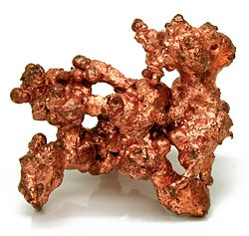
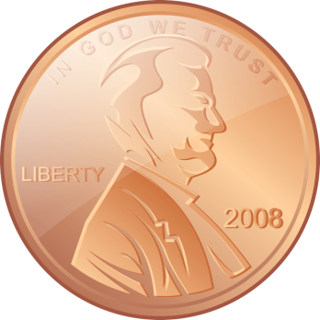
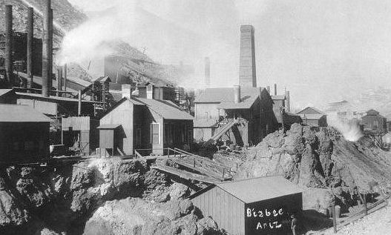
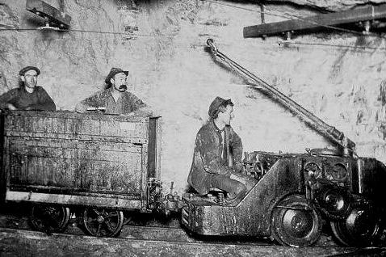
Copper Mining in Arizona
Early in its history, Arizona’s economy relied on the five C’s – copper, cotton, cattle, citrus, and climate (tourism). Today, the state is the top producer of copper in the United States, mining two-thirds of the copper produced in the country. One of the state’s nicknames is The Copper State.
From 1793 to 1857, a penny was made of all copper. Today, pennies are less than 1% copper on the inside with a thin layer of pure (100%) copper on the outside.
Fun Fact: It costs almost 2 and a half cents to make a penny.
Copper mining in Bisbee, AZ in the early 1900s
Notes:
Economy information retrieved 4/3/12 from http://en.wikipedia.org/wiki/Arizona#Economy
Penny information retrieved 4/3/12 from http://en.wikipedia.org/wiki/Penny_(United_States_coin)
Bisbee, AZ copper mine pictures retrieved 4/3/12 from http://www.miningartifacts.org/Arizona-Mines.html

Slide 24
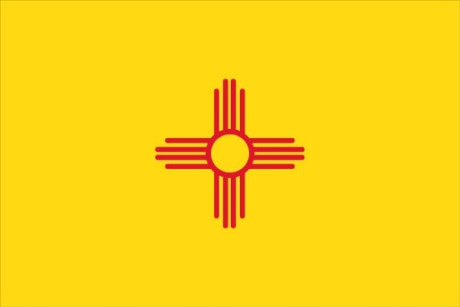
Welcome to New Mexico!
State Date: January 6, 1912
Nickname: Land of Enchantment
Motto: It grows as it goes.
Capital: Santa Fe
Flower: Yucca
Bird: Roadrunner
Tree: Piñon
Song: O, Fair New Mexico

Slide 25
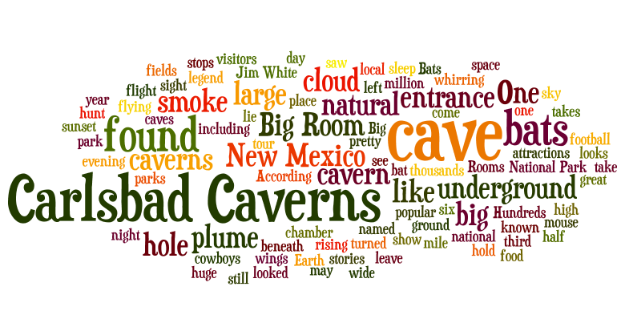
The next stop we will travel to is Carlsbad Caverns, New Mexico…
Notes:
National Parks Service Carlsbad Caverns web site - http://www.nps.gov/cave

Slide 26
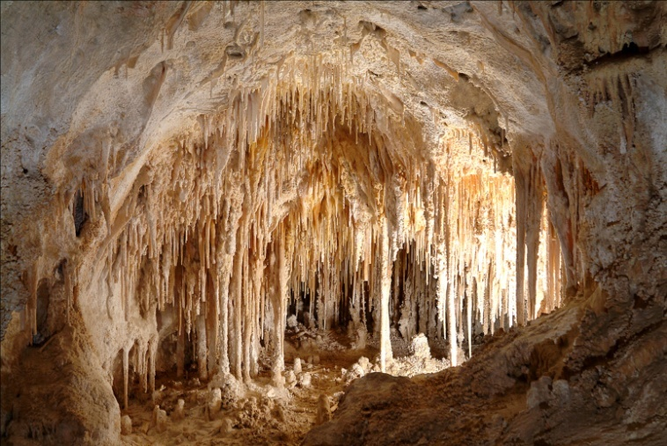
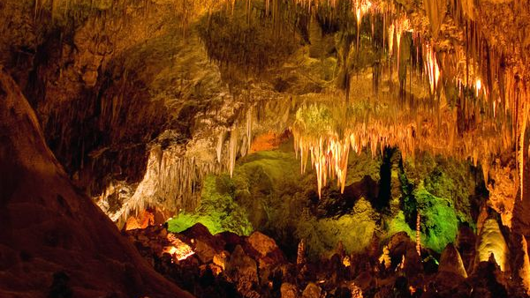
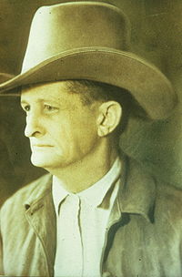
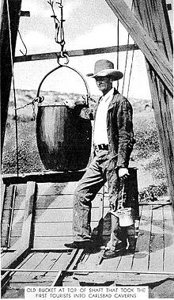
Stop 5: Carlsbad Caverns: Big Rooms and Bats in New Mexico
The first extensive exploration of the caverns was by cowboy and cave explorer Jim White. He first entered the caves in 1898 when he was only 16 years old. From 1926 to 1929, he was the Chief Ranger of Carlsbad Cave National Monument.
Notes:
cavern: a large cave
caves: natural underground holes
During early exploration of caves, Jim White made a ladder with rope, fence wire, and a hatchet. Used trail made by ball of string to find way back to cavern entrance. Mined guano (bat poop) to sell as fertilizer to California fruit orchards. He also used the guano bucket to transport first tourists in and out of the cavern.
Big Room image (color) retrieved 4/17/12 from http://travel.nationalgeographic.com/travel/national-parks/carlsbad-caverns-national-park/
Doll’s Theater in Big Room image retrieved 4/17/12 from http://www.nps.gov/cave/photosmultimedia/index.htm
Jim White images retrieved 4/21/12 from http://en.wikipedia.org/wiki/James_Larkin_White

Slide 27
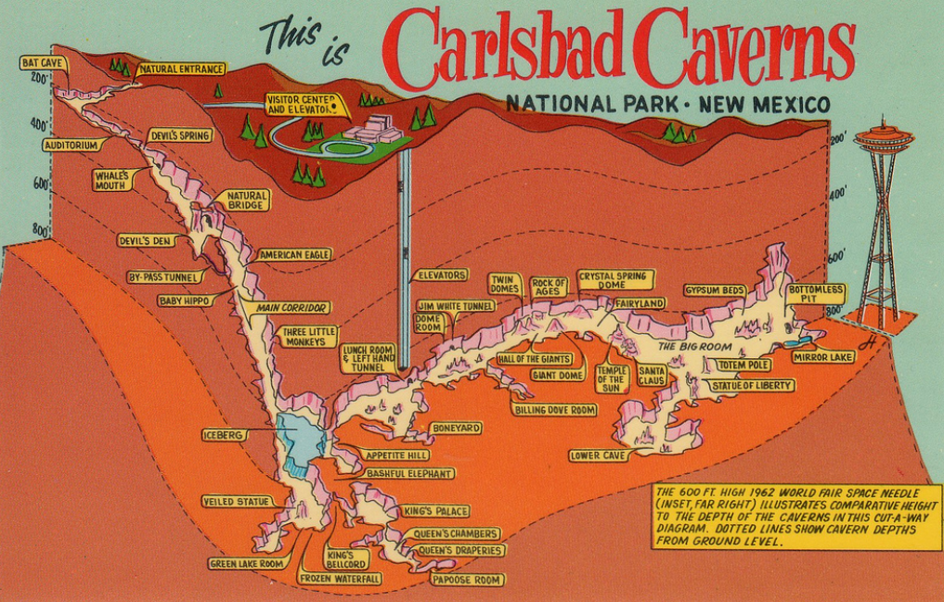
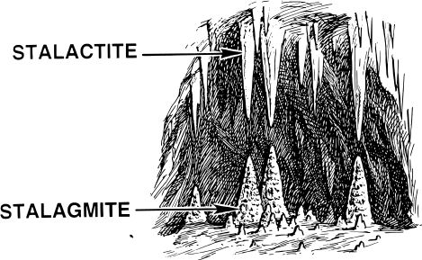
Stop 5: Carlsbad Caverns: Big Rooms and Bats in New Mexico
Carlsbad Caverns National Park has over 117 caves, but only a few of them are open to the public. You can enter Carlsbad Caverns through the natural entrance or by an elevator from the visitor center.
Fun Fact: Stalactites hang on tight to the ceiling. Stalagmites might reach the ceiling some day.
Notes:
speleothem: scientific name for cave formations (such as stalactites, stalagmites, columns, straws, flowstone, etc)
speleology: scientific exploration and study of caves
Carlsbad Caverns is located in the Guadalupe Mountains of southeastern New Mexico.
Big Room is 3rd largest cavern chamber in US, 7th largest in the world.
Map retrieved 4/17/12 from http://www.flickr.com/photos/31727570@N07/4415310042/

Slide 28
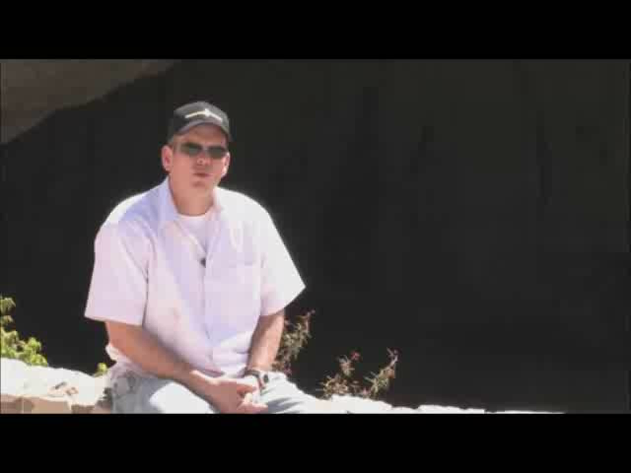

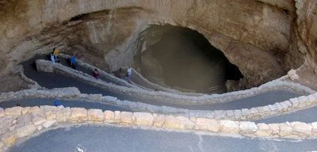
Stop 5: Carlsbad Caverns: Big Rooms and Bats in New Mexico
Carlsbad Caverns part 1 (Big Room) video (4:12)
Carlsbad Caverns part 2 (King’s Palace) video (4:35)
Notes:
Entrance picture shows winding path into caverns, takes you to 750 feet below surface. Bat amphitheater is located just above path. Visitor Center and 2 elevators were added in 1932.
Carlsbad Caverns part 1 (Big Room) video retrieved 4/17/12 from http://www.youtube.com/watch?v=qe7JRilIfi8
Carlsbad Caverns part 2 (King’s Palace) video retrieved 4/17/12 from http://www.youtube.com/watch?v=MVlDem2TXDg
Cavern entrance image retrieved 4/21/12 from http://ramblin-rover.blogspot.com/2008/07/carlsbad-caverns-national-park-new.html

Slide 29

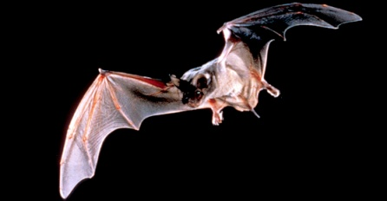

Stop 5: Carlsbad Caverns: Big Rooms and Bats in New Mexico
Carlsbad Caverns bat video (1:36)
There are 17 species of bats that live in the caves. In the summer, there are hundreds of thousands of Mexican free-tailed bats.
Notes:
Bats live in caves from about April/May until about October/November. They leave the caves beginning at about sunset, it can take 30 minutes to 3 hours for all bats to leave.
Bat image retrieved 4/17/12 from http://www.nps.gov/bibe/naturescience/interview_bat.htm
Carslbad bats video retrieved 4/17/12 from http://www.youtube.com/watch?v=yLufIO5fZ6o (1:36)

Slide 30

Welcome to Texas!
State Date: December 29, 1845
Nickname: Lone Star State
Motto: Friendship
Capital: Austin
Flower: Bluebonnet
Bird: Mockingbird
Tree: Pecan
Song: Texas, Our Texas

Slide 31

The next stop we will travel to is El Paso & Ciudad Juarez…

Slide 32




Stop 6: El Paso & Ciudad Juárez: 2 Cities, 2 Countries, 1 Border
The cities of El Paso and Ciudad Juárez are on opposite sides of the United States – Mexico border, the line that separates the two countries. American companies have built factories, called maquiladoras, in Ciudad Juárez because people in Mexico will work for less money than those in the United States. The products they make are driven back over the border in big rig trucks.
Notes:
border: a boundary line that separates two places
maquiladoras: factories across the border in Mexico
There is a lot of crime (many unsolved murders and drug-related crimes) in Ciudad Juarez.
Map retrieved 4/20/12 from http://www.nytimes.com/2011/02/15/world/americas/15juarez.html?_r=1
Original border marker images retrieved 4/20/12 from http://newmexiken.com/2012/01/el-paso/
Current border marker image retrieved 4/20/12 from http://www.hellonearthblog.com/2012/02/travel-fotos.html#!/2012/02/travel-fotos.html

Slide 33

The next stop we will travel to is San Antonio, Texas…

Slide 34



Stop 7: San Antonio, Texas: Home of the Alamo
Texas used to be part of Mexico, and the people that lived there were called Texians or Texicans. In 1836, Texians at the Alamo fought a battle during a rebellion against the Mexican government. Even though they lost that battle, the Texians did win the rebellion during the Battle of Jacinto later that year, and Texas became a country for nine years. In 1845, Texas joined the United States and became the 28th state.
Battle of the Alamo video (2:47)
Notes:
rebellion: an armed fight against a government
The rebellion is known as the Texas Revolution or Texas War of Independence. American immigrants to Texas began the rebellion because they disagreed with changes in Mexican government and laws which meant people had less independence and individual rights.
Alamo Deconstructed video retrieved 4/20/12 from http://www.youtube.com/watch?v=9dxGZhv4u8Y (2:47)
Alamo (today) image retrieved 4/20/12 from http://aries46.tripod.com/alamo.htm
Alamo movie set image retrieved 4/20/12 from http://www.latinamericanstudies.org/texas.htm

Slide 35

The next stop we will travel to is Austin, Texas…

Slide 36


Stop 8: Austin:
The Capital of Texas
The city of Austin is the state capital of Texas. Have you ever heard the saying “everything is bigger in Texas”? The capital building in Austin is the biggest one of any state in the country! Texas is not the biggest state though, it is the second biggest. Alaska is more than twice as large.
Just like the national capital makes laws for all of the United States, a state capital makes laws and decisions for the people in a state.
Downtown Austin tour video (2:21)
Notes:
capital: a city where the government of a country or state is located
Austin Capitol building is taller (308 ft) than the US Capitol (298 ft) in Washington, D.C.
Local motto is “Keep Austin Weird” – used to promote eccentricity and diversity, and support of local small businesses.
Downtown Austin tour video retrieved 4/20/12 from http://www.youtube.com/watch?v=t6Wi_ptZ35A (2:21)

Slide 37



Austin’s
Bats
During the summer, hundreds of thousands of migratory Mexican free-tailed bats live under the Congress Avenue Bridge in Austin. It is the world’s largest urban bat colony, and there are so many bats that they outnumber the human population of Austin. The bats hang beneath the bridge’s road deck in gaps in the concrete. Every night the bats emerge from under the bridge to eat bugs.
Austin bat video (1:38)
Notes:
There are an estimated 750,000 to 1.5 million bats in the colony, the population of Austin is about 750,000 people. The bats are a tourist attraction, and are used as a feature of the “Keep Austin Weird” campaign.
Bridge images retrieved 4/21/12 from http://en.wikipedia.org/wiki/Ann_W._Richards_Congress_Avenue_Bridge#Bats
Austin bats video retrieved 4/20/12 from http://www.youtube.com/watch?v=Ozv5N9boE9k (1:38)

Slide 38

Welcome to Oklahoma!
State Date: November 16, 1907
Nickname: Sooner State
Motto: Labor conquers all things.
Capital: Oklahoma City
Flower: Mistletoe
Bird: Scissor-tailed Flycatcher
Tree: Redbud
Song: Oklahoma!

Slide 39

The last stop we will travel to is Guthrie, Oklahoma…

Slide 40


Trail of Tears
During the1830s, the United States government made what is now Oklahoma an Indian Territory and forced many Native Americans to walk thousands of miles from their homelands to live in Oklahoma. Many of them died along the way and the journey is known as the Trail of Tears. The Indians were relocated so that white people could settle in the southeast.
Notes:
The Indian Removal Act of 1830 forced relocation of many Cherokee (in 1838), Muscogee aka Creek (in 1834), Seminole (in 1832), Chickasaw (in 1837), and Choctaw (in 1831) from their homelands in the southeast to the Indian Territory in what is now eastern Oklahoma. Many died of exposure, disease, or starvation, including 4,000 of the 15,000 relocated Cherokee.
Map and sign images retrieved 4/21/12 from http://en.wikipedia.org/wiki/Trail_of_tears

Slide 41

Stop 9: Guthrie, Oklahoma:
Center of the Land Rush
Land Rush video (3:32)
In 1889, the government decided that people besides Native Americans should also be able to settle in Oklahoma. They arranged a one day land rush beginning at noon on April 22, and about 50,000 settlers, mostly white, were able to claim free land (up to 160 acres) in Oklahoma.
According to the May 18, 1889 edition of Harper’s Weekly:
“At twelve o'clock on Monday, April 22d, the resident population of Guthrie was nothing; before sundown it was at least ten thousand. In that time streets had been laid out, town lots staked off, and steps taken toward the formation of a municipal government."
Notes:
Land Rush (from the movie “Far & Away”) video retrieved 4/20/12 from http://www.youtube.com/watch?v=yxaJY8UZxn4
Harper’s Weekly quote retrieved 4/21/12 from http://www.library.cornell.edu/Reps/DOCS/landrush.htm

Slide 42


Activity Introduction:
Land Rush Recreation
You will each get a Land Rush Role Card. Read your role carefully, it will be important throughout the activity.
American Indian
Boomer, Rancher, or Railroad Worker
Sooner
Land Rush Participant
Line up around the outside of the space that is representing Oklahoma.
Notes:
Preview Land Rush Recreation activity during PowerPoint presentation. Complete actual activity outside due to classroom space constraints. Have color coded role and fate cards, as well as handouts, prepared in advance.
Land Rush image retrieved 3/18/2012 from http://csmh.pbworks.com/f/1188532024/okrush89.gif

Slide 43

Activity Phase 1:
Land Rush Recreation
In Phase 1 (1830s), American Indians are forced to move into Oklahoma. Cherokees were forced to march more than 1000 miles to settle in Indian Territory. Many died along the way and the journey became known as the Trail of Tears.
If you have an American Indian role card, move into Oklahoma now.
Question 1
How do you feel about being moved to a new home?
Question 2
How do you feel about having your own area, far away from white settlers?

Slide 44

Activity Phase 2:
Land Rush Recreation
In Phase 2 (1870s and 1880s), states near Oklahoma had many white settlers. Boomers moved into Indian Territory, but most were forced to leave. Ranchers drove their cattle through Oklahoma and put up fences. In 1887 the railroad across Oklahoma was completed and Railroad Workers moved into the state.
If you have a Boomer, Rancher, or Railroad Worker role card, move into Oklahoma now.
Question 1
Why have you decided to move into Indian Territory?
Question 2
How will you deal with American Indians, since they own this land?

Slide 45

Activity Phase 3:
Land Rush Recreation
In Phase 3 and 4 (1889), the government bought some of the American Indian lands and scheduled a race for white settlers to claim land.
Sooners were people who sneaked in before they were supposed to. They wanted to get the best land before the race even started.
If you have a Sooner role card, move into Oklahoma now. A Fate Card lying face down on the floor will tell you what happens to you in Oklahoma.
Questions for American Indians, Boomers, Ranchers, and Railroad Workers
What do you think of the land rush?
How do you think it might change your lives?

Slide 46

Activity Phase 4:
Land Rush Recreation
Land Rush Participants waited for the start signal of the race to claim land.
If you have a Land Rush Participants role card, move into Oklahoma now. A Fate Card lying face down on the floor will tell you what happens to you in Oklahoma.
Interview classmates with each of the roles to complete your handout. How was the experience different for American Indians, Boomers, Ranchers, Railroad Workers, Sooners, and Land Rush Participants?
Questions for all roles
How did you feel during this activity?
What was your experience of settling in Oklahoma?
Do you think there was a better way to decide who got land in Oklahoma?

