Slide 1
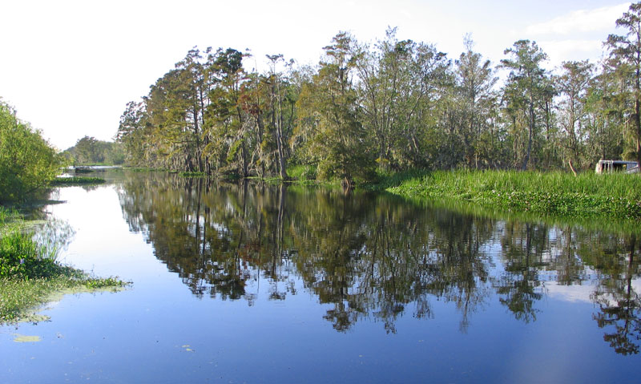
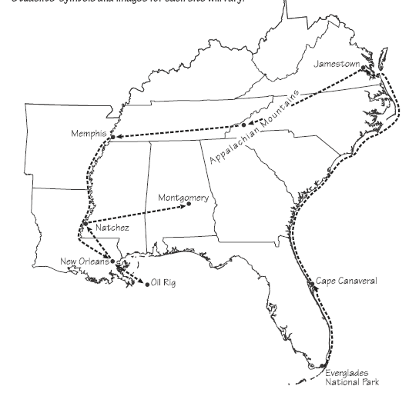
A Boat & Bus
Tour of the Southeast
PowerPoint presentation by Mrs. LeFave & Mrs. Daniels

Slide 2
Southeast Region Tour
Stop 1: Everglades National Park, Florida
Stop 2: The Kennedy Space Center at Cape Canaveral, Florida
Stop 3: Jamestown, Virginia: England’s First American Colony
Stop 4: A Coal Mine in Appalachia
Stop 5: Musical Memphis, Tennessee
Stop 6: The French Quarter in New Orleans, Louisiana
Stop 7: An Oil Rig in the Gulf of Mexico
Stop 8: A Cotton Plantation in Natchez, Mississippi
Stop 9: Montgomery, Alabama: Birthplace of the Civil Rights Movement
Notes:
Text from stops audio files retrieved 3/2/2012 from http://sas-origin.OnstreamMedia.com/origin/tci/public/4_ROC

Slide 3
Traveling by Boat & Bus
What are the different ways land is used in the Southeast?
What are the different types of music in the Southeast?
How has the Southeast changed over time?
Notes:
Big rig image retrieved 3/2/2012 from http://www.autoblog.com/2007/05/09/freighliner-announces-new-big-rig-the-cascadia/
Big rig wav files retrieved 3/2/2012 from http://www.autospeak.com/library.htm

Slide 4
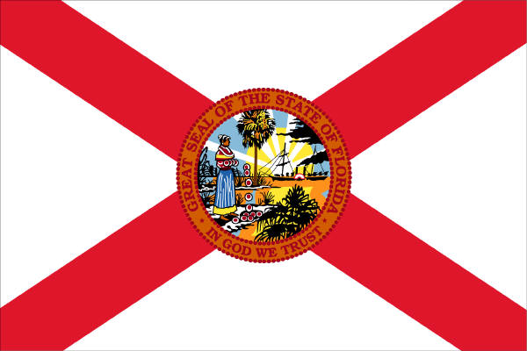
Welcome to Florida!
State Date: March 3, 1845
Nickname: Sunshine State
Motto: In God we trust
Capital: Tallahassee
Flower: Orange Blossom
Bird: Mockingbird
Tree: Sabal Palmetto Palm
Song: Old Folks at Home

Slide 5
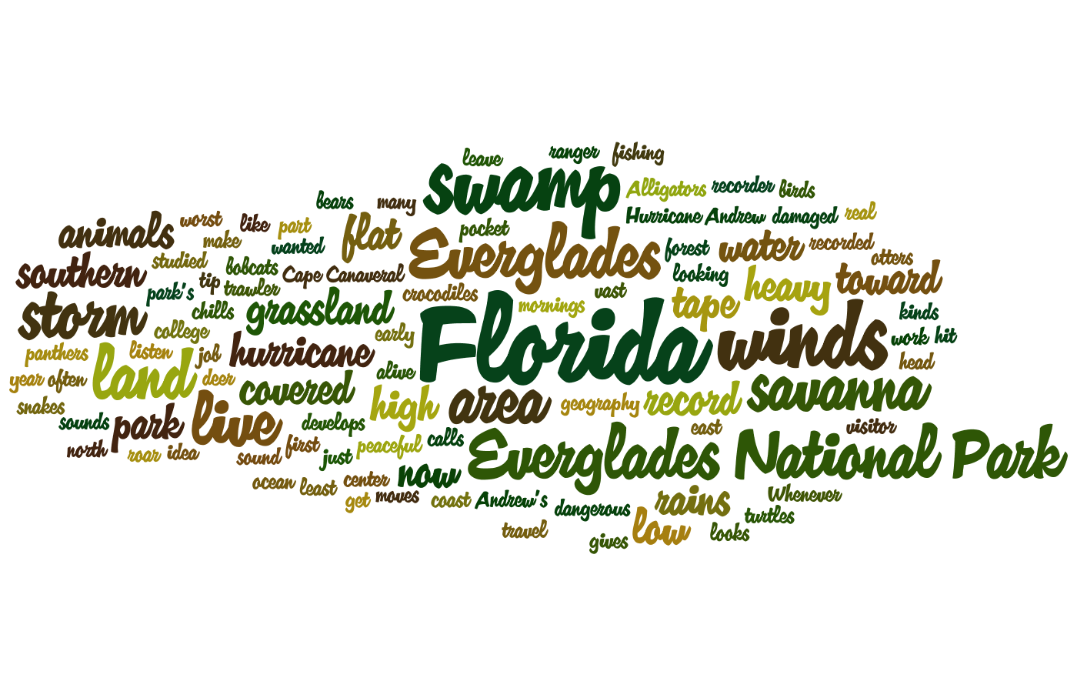
The first stop we will travel to is Everglades National Park…

Slide 6
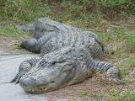
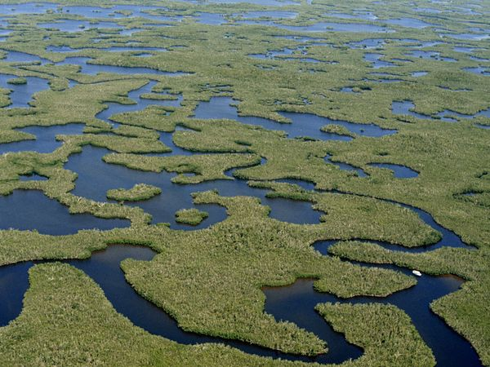
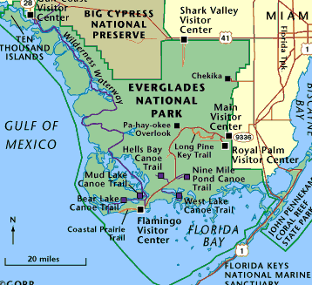
Stop 1: Everglades National Park, Florida
The southern tip of Florida is covered with a huge swamp called the Everglades. A swamp is a low area of land that is covered by water at least part of the year. The Everglades is home to lots of wildlife. Alligators, crocodiles, turtles, snakes, otters, deer, bear, panther, bobcats, rabbits and birds all live in the Everglades.

Slide 7

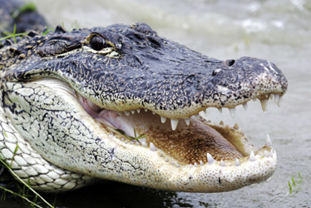
Stop 1: Everglades National Park, Florida
Make a prediction. What do you think you might see here at the Everglades?
What should you do to prepare for this trip?
What would you bring with you?
What would you wear?
Everglades airboat ride video (4:33)

Slide 8
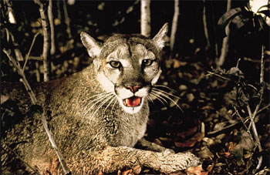
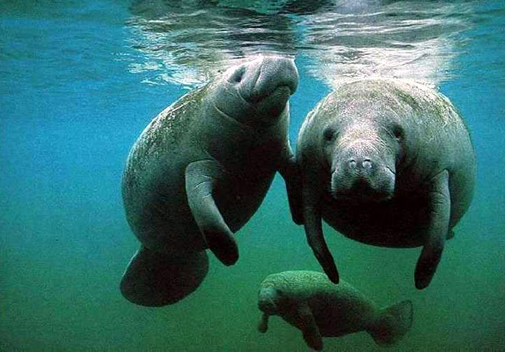
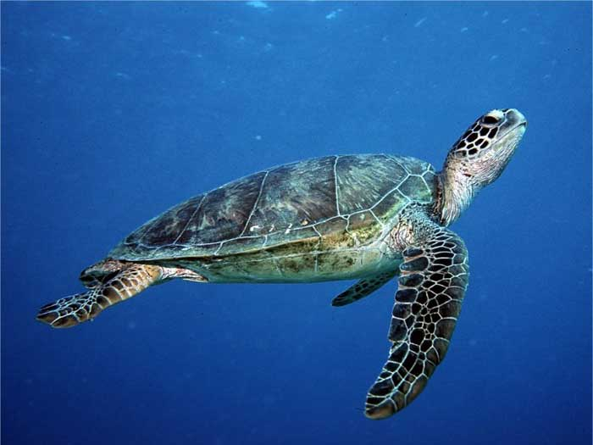
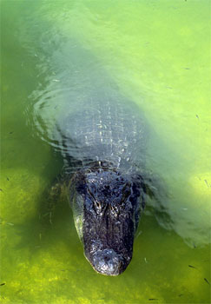
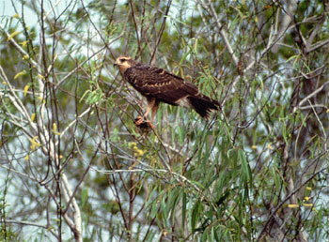
Stop 1: Everglades National Park, Florida
The Everglades has at least 67 species of plants or animals that are endangered. An animal or plant is considered endangered if they are in danger of becoming extinct.
Florida Panther
West Indian Manatee
Green Turtle
Snail Kite
American Alligator

Slide 9

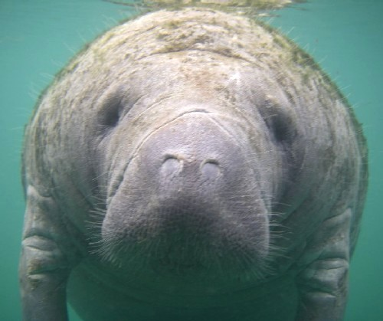
Stop 1: Everglades National Park, Florida
Why are species becoming endangered?
Loss of habitat
Changing water flow
Drainage of wetlands
Introduction of non-native organisms
Poisoning
What can we do to help?
Become informed about endangered species
Not buying products made from endangered animals
Being mindful of the environment and how people can affect animal habitats- littering, pollution, cutting down trees, building new roads, etc.
Donating money to organizations that help save wild animals and their habitats

Slide 10
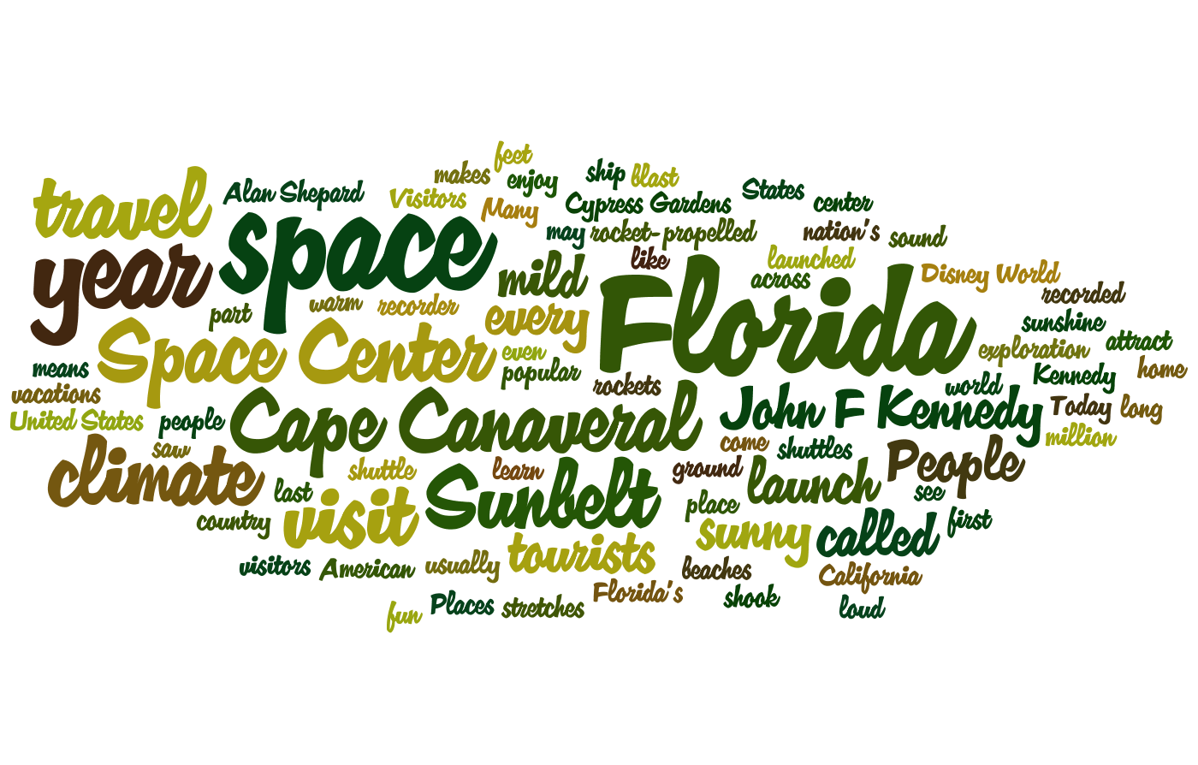
The next stop we will travel to is Kennedy Space Center…

Slide 11
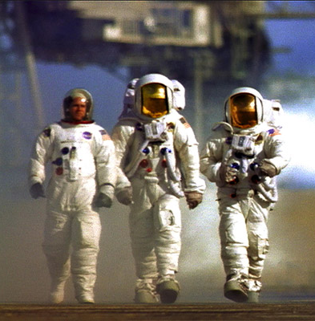
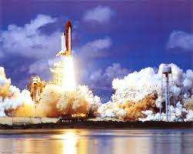
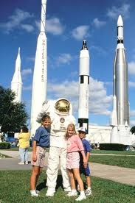
Stop 2: Kennedy Space Center at Cape Canaveral, Florida
The Kennedy Space Center is a place in Florida where space shuttles can launch from. Launch means to take off or blast into space. Many tourists visit the Kennedy Space Center each year. The first American astronaut was launched from the Kennedy Space Center in 1961.

Slide 12

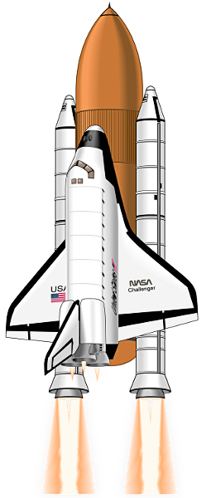
Stop 2: Kennedy Space Center at Cape Canaveral, Florida
Shuttle Discovery launch video (4:38)
Let’s Watch the Shuttle Discovery’s Last Launch from Cape Canaveral on February 24, 2011…

Slide 13
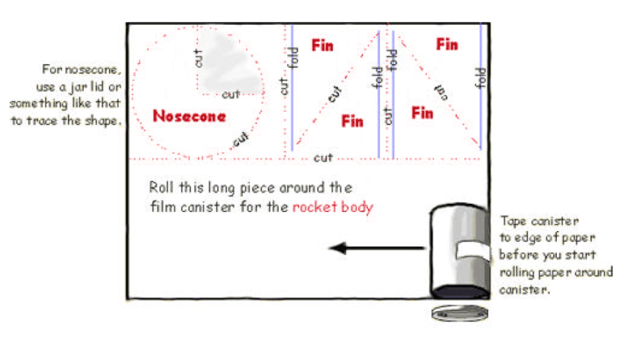
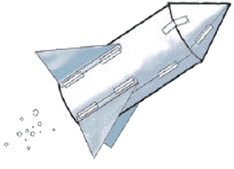
Activity: Build a Bubble-Powered Rocket
Build your own rocket using paper and fizzing tablets! Watch it lift off. How high does your rocket go?
Make your rocket:
Cut out all the paper pieces (nosecone and fins) for your rocket.
Roll the paper circle into a cone and tape it to the bottom of the canister. The canister lid needs to sit on the ground to blast off.
Tape fins to the canister, if you want.
Blasting off:
Put on eye protection. Or stand back!
Turn the rocket upside down and remove the canister’s lid.
Fill the canister 1/3 full of water.
Work quickly on the next steps!
Drop 1/2 of a fizzing antacid tablet into the canister.
Snap the lid on tight.
Stand your rocket on a launch platform (sidewalk or driveway).
Stand back and wait. Your rocket will blast off!

Slide 14
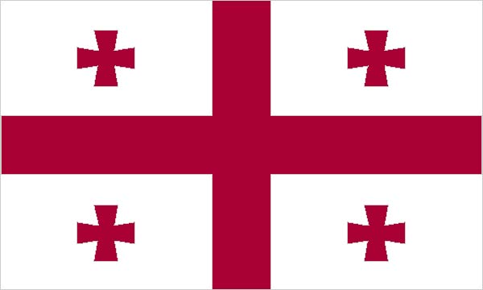
Welcome to Georgia!
State Date: January 2, 1788
Nickname: Empire State of the South, Peach State
Motto: Wisdom, justice, and moderation
Capital: Atlanta
Flower: Cherokee Rose
Bird: Brown Thrasher
Tree: Live Oak
Song: Georgia on My Mind

Slide 15

Georgia…
Georgia video (3:51)
Notes:
Georgia video retrieved 9/22/2013 from http://www.youtube.com/watch?v=ObKPoyq7Xho

Slide 16
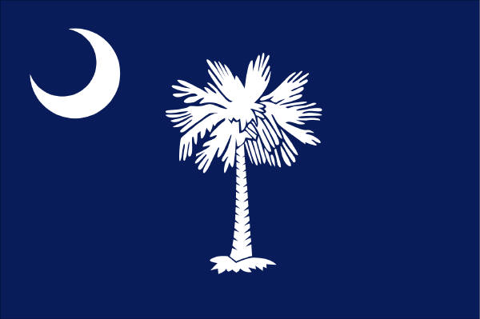
Welcome to South Carolina!
State Date: May 23, 1788
Nickname: Palmetto State
Motto: While I breath, I hope
Capital: Columbia
Flower: Carolina Yellow Jessamine
Bird: Great Carolina Wren
Tree: Palmetto
Song: Carolina

Slide 17
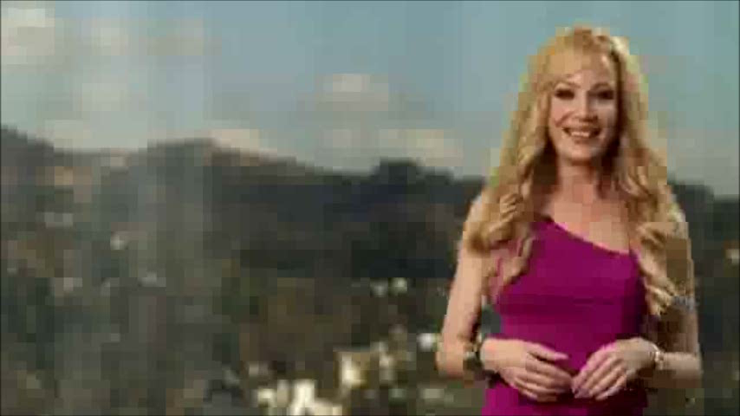
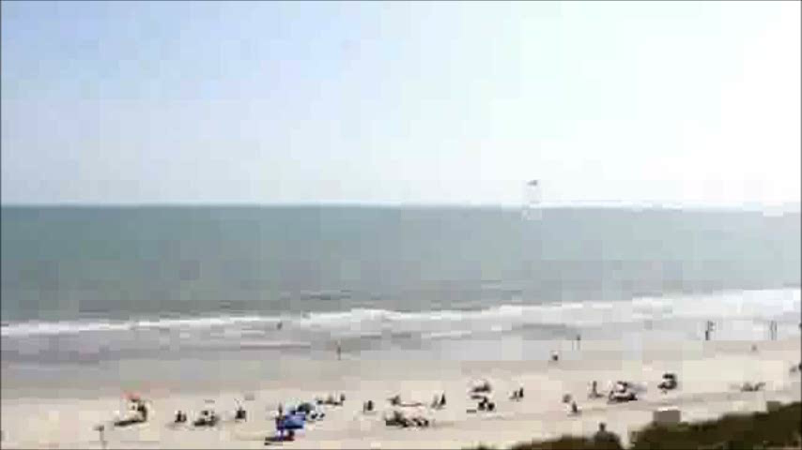
South Carolina
Myrtle Beach video (2:55)
Best of South Carolina video (3:51)
Notes:
South Carolina video retrieved 9/22/2013 from http://www.youtube.com/watch?v=86t4c-OHa8U
Myrtle Beach video retrieved 9/22/2013 from http://www.youtube.com/watch?v=FVPObsL5geU

Slide 18
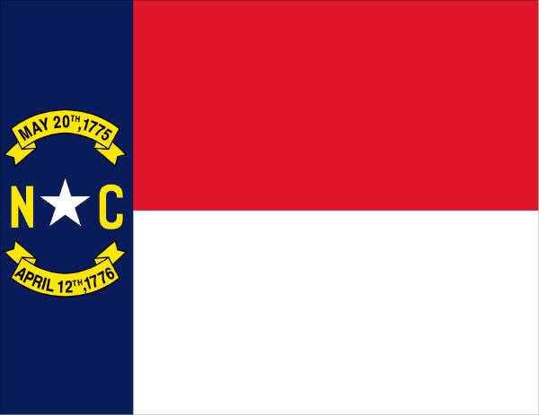
Welcome to North Carolina!
State Date: November 21, 1789
Nickname: Tar Heel State
Motto: To be rather than to seem
Capital: Raleigh
Flower: Dogwood
Bird: Cardinal
Tree: Pine
Song: The Old North State

Slide 19


North Carolina
Cherokee of North Carolina video (2:21)
North Carolina video (2:53)
Notes:
North Carolina video retrieved 9/22/2013 from http://www.youtube.com/watch?v=ouiGr1cQR7c
Cherokee NC video retrieved 9/22/2013 from http://www.youtube.com/watch?v=PJqzUbg0n1A

Slide 20
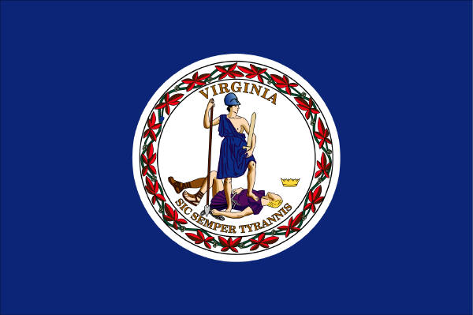
Welcome to Virginia!
State Date: June 25, 1788
Nickname: Old Dominion
Motto: Thus always to tyrants
Capital: Richmond
Flower: Dogwood
Bird: Cardinal
Tree: Dogwood
Song: Carry Me Back to Old Virginia

Slide 21
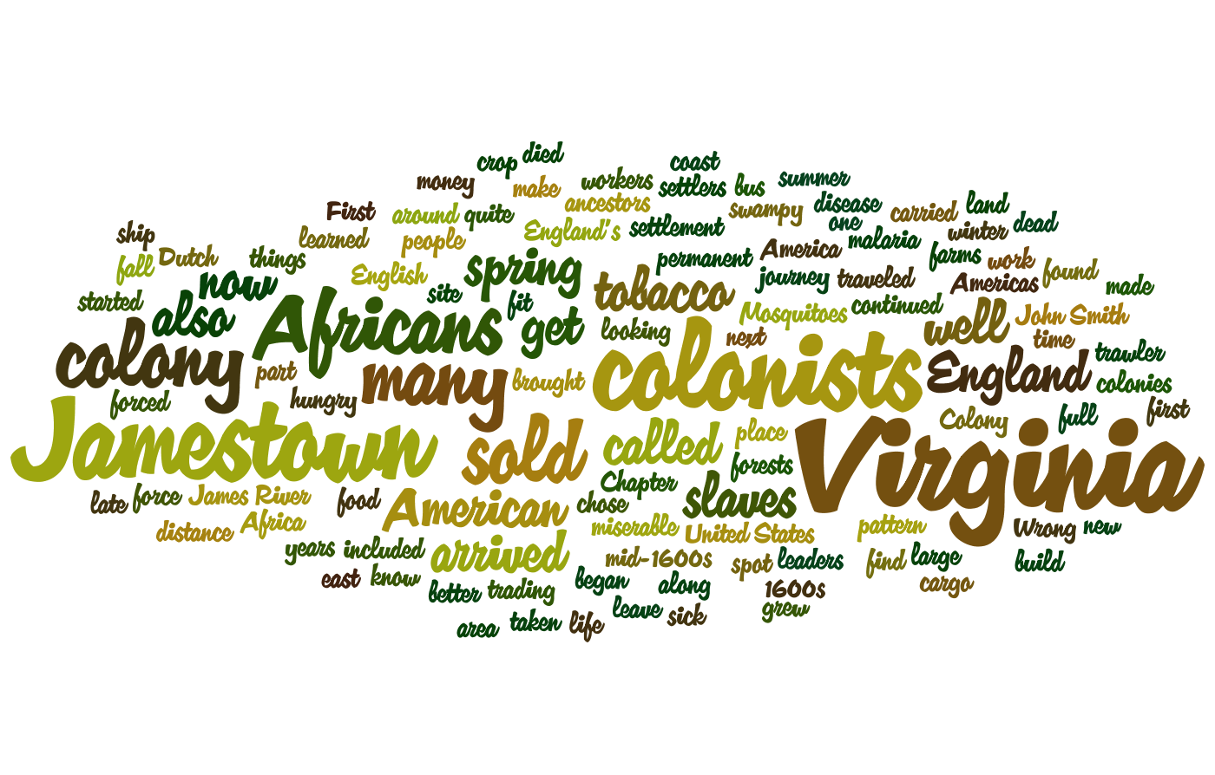
The next stop we will travel to is Jamestown, Virginia…

Slide 22
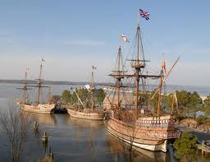
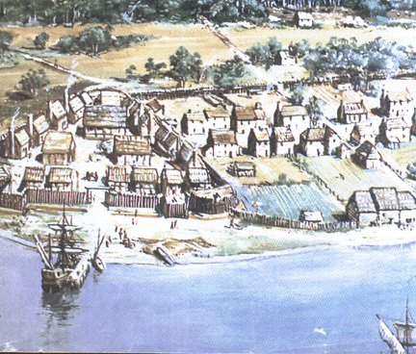
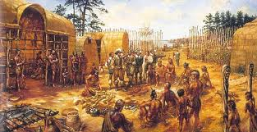
Stop 3: Jamestown, Virginia: England’s First American Colony
In the spring of 1607, settlers from England chose Jamestown to build a colony. Jamestown was a hard places to live. It was full of mosquitoes, and food was hard to find. Many colonists got sick and died. Some of the colonists did survive and Jamestown was the 1st permanent colony in America.

Slide 23
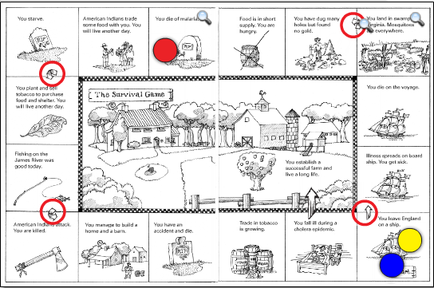
Activity: Jamestown, Virginia: The Survival Game
To find out what it was like in Jamestown, you and your group will play The Survival Game.
You will need:
a copy of the game board
1 dice
3 game pieces
Put your game pieces on Start.
Take turns rolling the dice.
Move your game piece the number of spaces that appear on the dice. Follow the arrows.
If you land on a grave marker, you are out of the game.
Play the game four times. See how many times each player can survive.

Slide 24
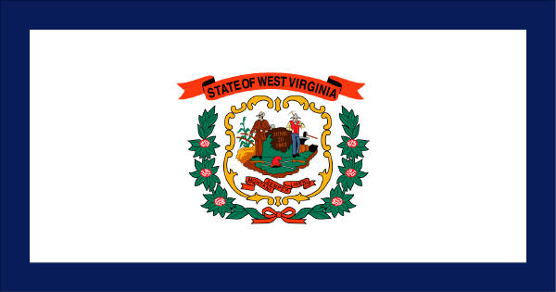
Welcome to West Virginia!
State Date: June 20, 1863
Nickname: Mountain State
Motto: Mountaineers are always free
Capital: Charleston
Flower: Big Rhododendron
Bird: Cardinal
Tree: Sugar Maple
Song: The West Virginia Hills; This Is My West Virginia; West Virginia, My Home

Slide 25
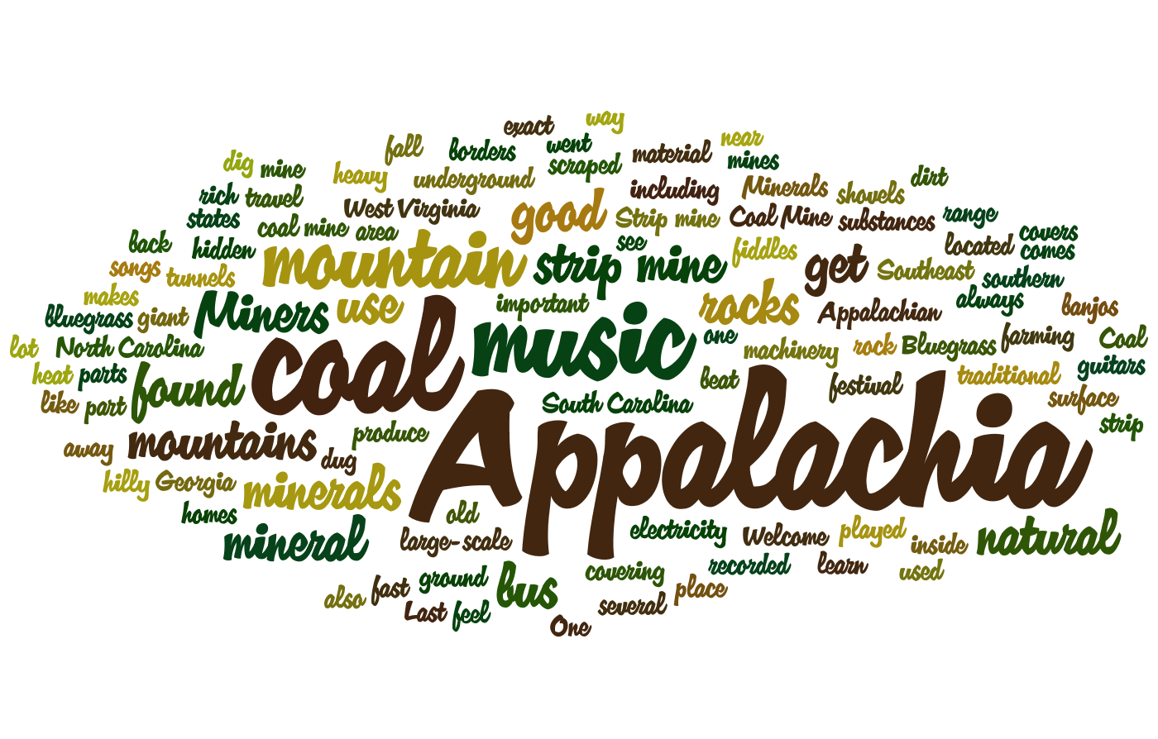
The next stop we will travel to is a Coal Mine in Appalachia…

Slide 26
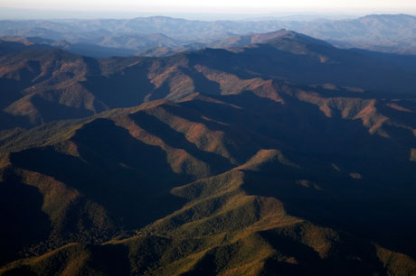
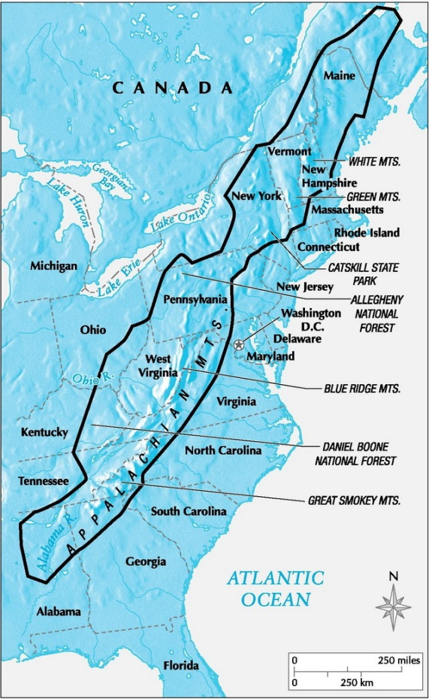
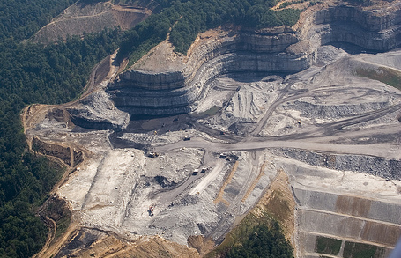
Stop 4: A Coal Mine in Appalachia
What is Appalachia?
Appalachia is not a state, a city, or a park. It is the name of a mountainous region. What do you think mountainous means? That’s right! It has lots of mountains! It is part of the Appalachian Mountain Range. Appalachia covers parts of 13 states in the Southeast region!
What do people do in Appalachia?
Appalachia is rich in minerals that are found in rocks. Coal is the most important mineral found in Appalachia. Coal is used to heat homes and produce electricity.

Slide 27
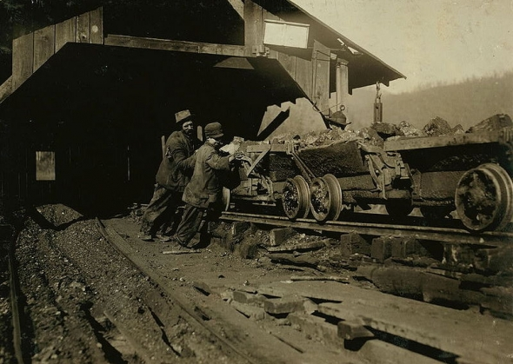
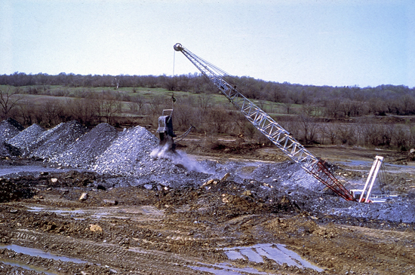
Stop 4: A Coal Mine in Appalachia
Past vs. Present
In the past, miners dug tunnels in the Appalachian Mountains to get to the coal inside. These underground mines were dangerous places. Many people died in mining accidents.
Today most coal comes from strip mines. Strip mines are surface mines. Miners use heavy machinery to strip away the dirt and rocks covering the coal. Then they use giant shovels to dig the coal out of the mountain.

Slide 28

Stop 4: A Coal Mine in Appalachia
Coal Mining… How do they do it?
Coal mining video (5:44)

Slide 29
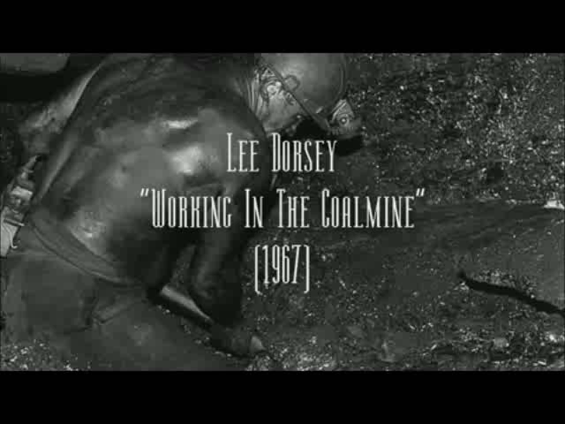
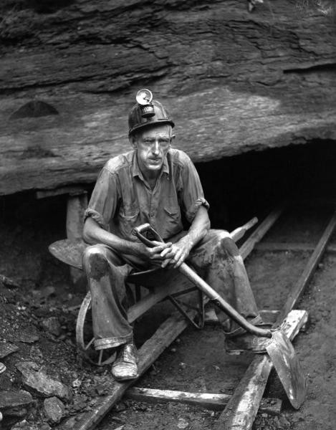
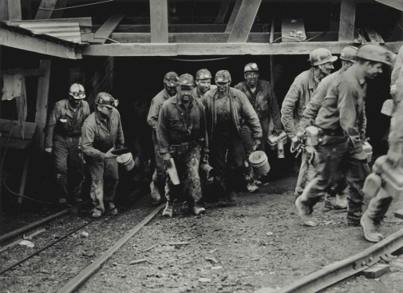
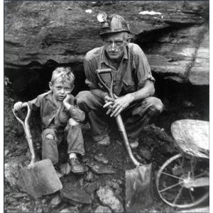
Stop 4: A Coal Mine in Appalachia
Lee Dorsey wrote the song “Working in the Coal Mine” in 1966.
“Working in the Coalmine” slideshow (2:51)
Pictures from Mining in the Past

Slide 30

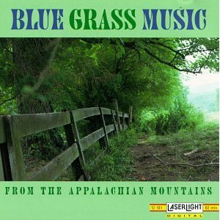

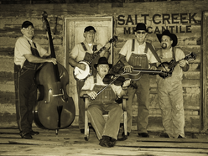

Music: Bluegrass
Bluegrass is the traditional music of Appalachia. It has a fast beat and often includes banjos, fiddles, and guitars.
“Salt Creek” audio (2:21)
“Cool Spring Water” video (3:35)

Slide 31
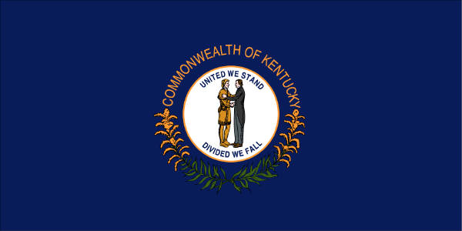
Welcome to Kentucky!
State Date: June 1, 1792
Nickname: Bluegrass State
Motto: United we stand, divided we fall
Capital: Frankfort
Flower: Goldenrod
Bird: Cardinal
Tree: Tulip Poplar
Song: My Old Kentucky Home

Slide 32
Kentucky…
Kentucky video (2:39)
Notes:
Kentucky video retrieved 9/22/2013 from http://www.youtube.com/watch?v=RSeAMPtdTFk

Slide 33
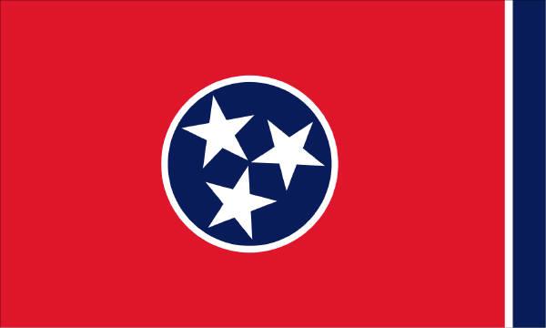
Welcome to Tennessee!
State Date: June 1, 1796
Nickname: Volunteer State
Motto: Agriculture and commerce
Capital: Nashville
Flower: Iris
Bird: Mockingbird
Tree: Tulip Poplar
Song: Tennessee Waltz

Slide 34
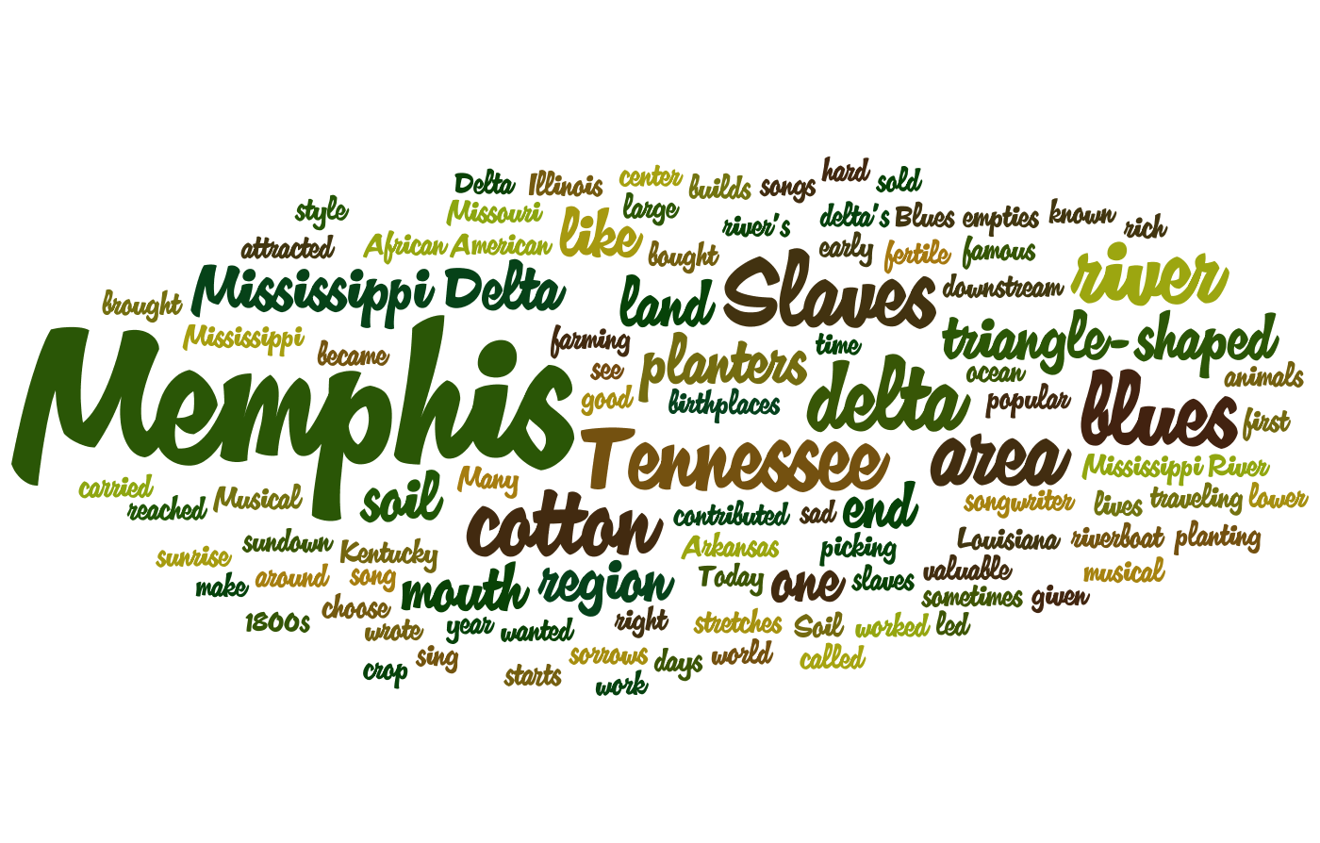
The next stop we will travel to is Memphis, Tennessee…

Slide 35
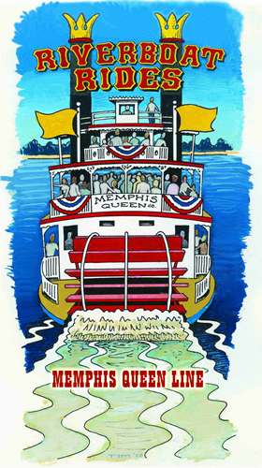
Stop 5: Musical Memphis, Tennessee
Memphis is located right on the Mississippi River. Many riverboats cruise the Mississippi River each day.
In the early 1800’s, the rich soil in Memphis attracted cotton planters to the region. Many planters brought slaves with them to do the work of planting and picking cotton. Slaves led hard lives. They worked from sunup to sundown almost every day. They had no right to do what they wanted to do. They were bought and sold like cattle.

Slide 36
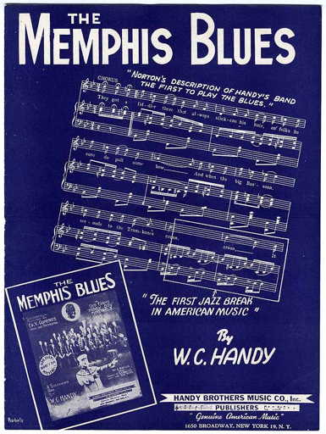

Music: Blues
Sometimes slaves in the South would sing about their sorrows. These sad songs came to be known as the blues. Memphis is known all around the world as home of the blues.
“Low Life Street Blues” audio (2:45)

Slide 37

Welcome to Arkansas!
State Date: June 15, 1837
Nickname: The Natural State, The Razorback State
Motto: The people rule
Capital: Little Rock
Flower: Apple Blossom
Bird: Mockingbird
Tree: Pine
Song: Arkansas

Slide 38

Arkansas…
Arkansas video (2:02)
Notes:
Arkansas video retrieved 9/22/2013 from http://www.youtube.com/watch?v=bAC_t8GqkBY

Slide 39

Welcome to Louisiana!
State Date: April 30, 1812
Nickname: Pelican State
Motto: Union, justice, and confidence
Capital: Baton Rouge
Flower: Magnolia
Bird: Eastern Brown Pelican
Tree: Bald Cypress
Song: Give Me Louisiana

Slide 40

The next stop we will travel to is New Orleans, Louisiana…

Slide 41

We will travel to New Orleans, Louisiana by riverboat…
Riverboat video (2:28)

Slide 42



Even Mickey enjoys travelling by riverboat!
Fun Fact: “Steamboat Willie,” made in 1928, was one of Mickey’s first cartoons!
“Steamboat Willie” video (0:47)

Slide 43




Stop 6: The French Quarter in New Orleans, Louisiana
New Orleans is the largest city in Louisiana. The French Quarter is the oldest neighborhood in the city and still has houses similar to those built by the original colonists.
Mardi Gras video (3:11)
Mardi Gras is a celebration held in New Orleans in late February or early March each year. There are parades and people eat king cake.

Slide 44



Music: Jazz
“Now You Has Jazz” video (4:46)
New Orleans is the birthplace of jazz. This style of music was created by African American musicians living in the area.
One of the most famous jazz musicians was Louis Armstrong. He was a trumpet player and singer who first became famous in the 1920s.

Slide 45

The next stop we will travel to is the Gulf of Mexico…

Slide 46



Stop 7: An Oil Rig in the Gulf of Mexico
Oil rig video (1:39)
Petroleum, or oil, is found underground and under the ocean floor. In the Gulf of Mexico, big platforms, or rigs, hold machinery that drills under the sea. Oil is then taken to refineries and factories to make gasoline, plastics, and other products.

Slide 47




Stop 7: An Oil Rig
Dangers of Oil Rigs
Oil spills and accidents on oil rigs in the Gulf of Mexico are a serious problem. They cause a lot of harm to the environment and to animals who make the Gulf Coast area their home, and also hurt the fishing industry. It is very difficult to clean up oil spills, and costs a lot of money.

Slide 48

Welcome to Mississippi!
State Date: December 10, 1817
Nickname: Magnolia State
Motto: By valor and arms
Capital: Jackson
Flower: Magnolia
Bird: Mockingbird
Tree: Magnolia
Song: Go, Mississippi

Slide 49

The next stop we will travel to is Natchez, Mississippi…

Slide 50



Stop 8: A Cotton Plantation in Natchez, Mississippi
In the 1800s, cotton planters settled in the Natchez area. Many of them became rich and built big homes on their plantations, or large farms. Black slaves worked on the cotton plantations.
During the American Civil War, the North and South fought about whether or not there should be slavery in the United States. After the Civil War, slavery was ended.
Most of the plantation homes in Natchez survived the Civil War without being damaged and are still standing today.
Natchez, Mississippi video (2:22)

Slide 51




Stop 8: A Cotton Plantation
Growing cotton is still an important industry in the southern United States. Cotton is not just used to make fabric and clothing, parts of the plant are also used in food and other products.
The United States is currently the largest exporter of cotton in the world.
The Story of Cotton video (5:12)

Slide 52

Welcome to Alabama!
State Date: December 14, 1819
Nickname: Heart of Dixie, Cotton State
Motto: We dare maintain our rights
Capital: Montgomery
Flower: Camellia
Bird: Yellowhammer
Tree: Southern Longleaf Pine
Song: Alabama

Slide 53

The last stop we will travel to is Montgomery, Alabama…

Slide 54




Stop 9: Montgomery, Alabama: Birthplace of the Civil Rights Movement
Even though blacks in the South were free after the Civil War, they were still denied many rights. They were segregated, or separated, because of their skin color. African Americans could not go to school or eat at the same places as white people in the South.
“I Have a Dream” speech video (17:28)
Martin Luther King Jr., a Baptist minister, was an important leader in the Civil Rights Movement of the 1950s and 1960s.

Slide 55





Montgomery Bus Boycott, 1955
Stop 9: Montgomery, Alabama:
In Montgomery, blacks could not sit next to whites on the bus. If there weren’t enough seats, blacks had to give up their seats. On December 1, 1955, Rosa Parks refused to give up her seat on the bus to a white man.
After she was arrested, African Americans in Montgomery refused to ride the buses. For over a year, they walked, rode bikes, or carpooled instead of riding the bus.
In December 1956, Montgomery was forced by the U.S. Supreme Court to end bus segregation.

