Slide 1
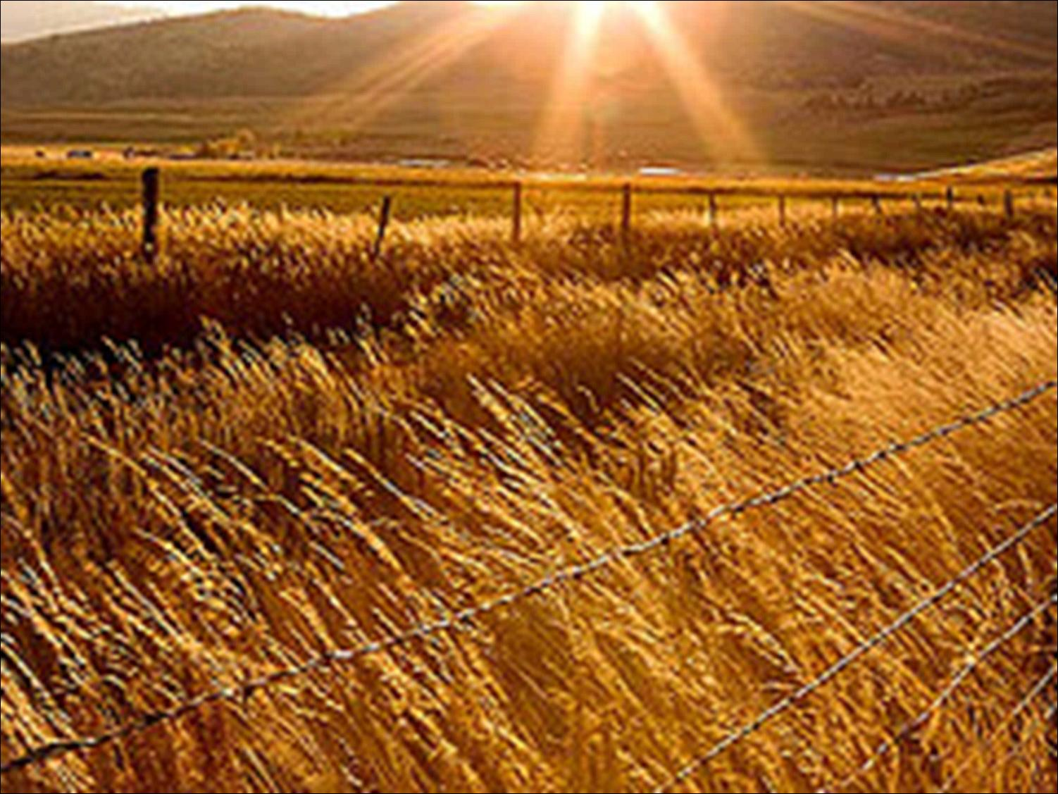
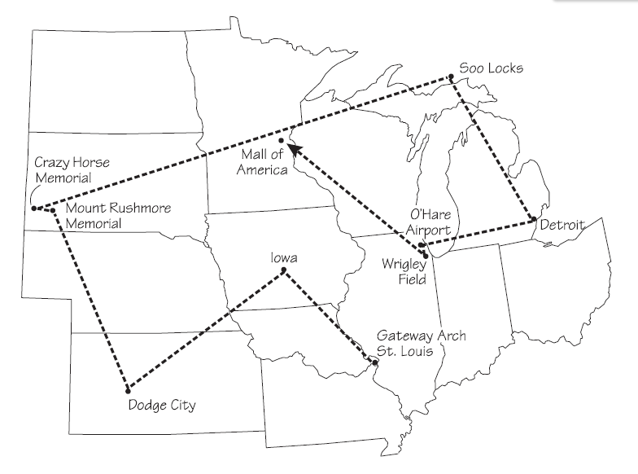
A Crop Duster
Tour of the Midwest
PowerPoint presentation by Mrs. LeFave & Mrs. Daniels
Notes:
Background image retrieved on 1/27/2012 from http://www.thehappyrock.com/2007/10/10/40-acres-and-a-mule-free-land-still-available-in-the-united-states/
Crop duster image retrieved on 1/27/2012 from http://www.landairsea.com/gps-tracking-blog/gps-tracking-helps-farmers-cut-costs-benefit-environment/

Slide 2
Midwest Region Tour
Stop 1: St. Louis, Missouri: Gateway to the West
Stop 2: The Farm State of Iowa
Stop 3: Dodge City, Kansas: Where the Cattle Once Roamed
Stop 4: South Dakota’s Heroes
Stop 5: Michigan’s Soo Locks: Linking the Great Lakes
Stop 6: Detroit, Michigan: America’s Motor City
Stop 7: O’Hare International Airport: The Midwest’s Transportation Hub
Stop 8: Chicago’s Wrigley Field
Stop 9: Minnesota’s Mall of America

Slide 3
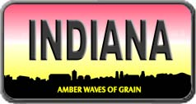
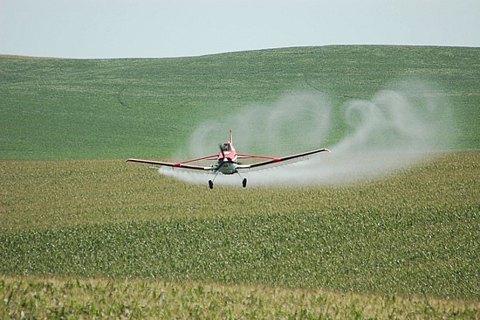

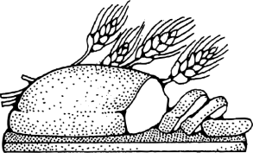
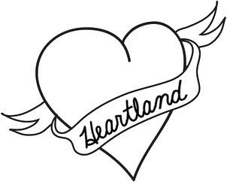
Traveling by
Crop Duster
During our tour of the Midwest Region, we will travel in planes called crop dusters. They are small planes that fly close to the ground and spray chemicals on crops.
Why do you think we will be travelling through this region in a crop duster?
The Midwest
is also called
America’s Breadbasket
or America’s Heartland
How did the Midwest get it’s two very different nicknames?
Notes:
Students should look for answers to the question about the Midwest’s two nicknames throughout the tour, the question is revisited in the summary at the end of the chapter in the textbook

Slide 4
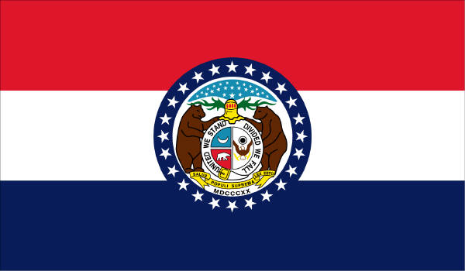
Welcome to Missouri!
State Date: August 10, 1821
Nickname: Show Me State
Motto: The welfare of the people shall be the supreme law.
Capital: Jefferson City
Flower: Hawthorn
Bird: Bluebird
Tree: American Dogwood
Song: Missouri Waltz

Slide 5
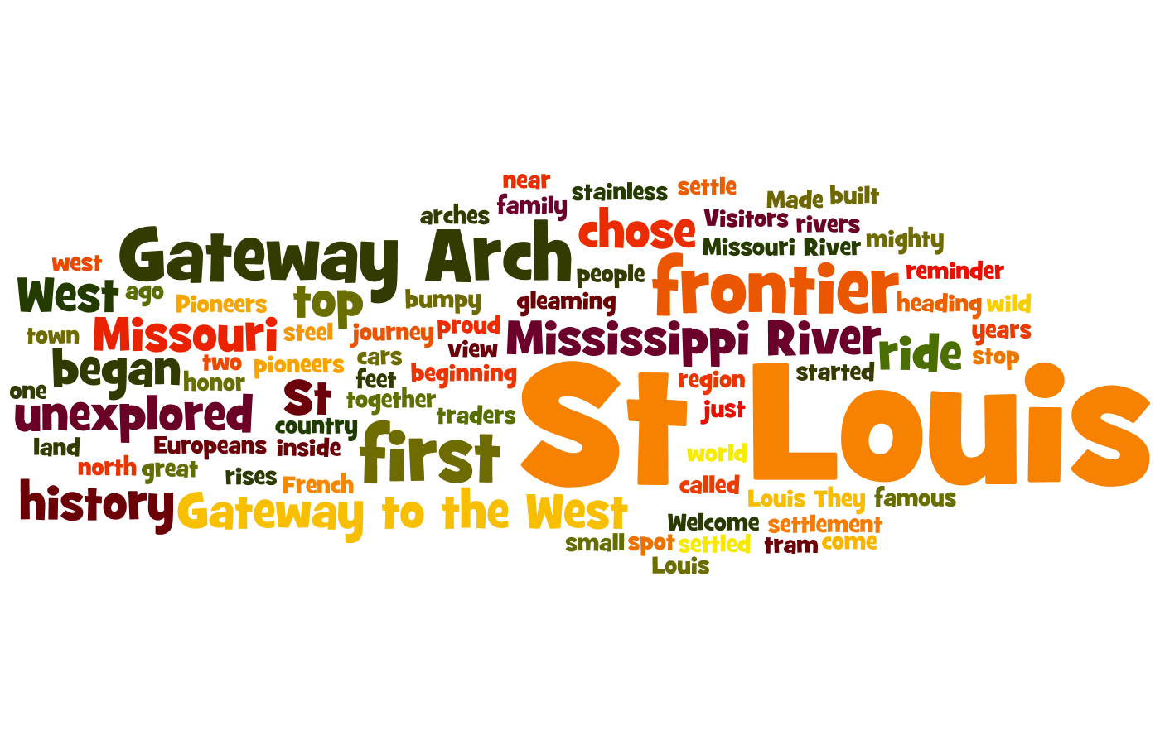
The first stop we will travel to is St. Louis, Missouri…
Notes:
This wordle has all the words we will read in the textbook about the stop. The words that are bigger are in the reading more times, the smallest words are only in the reading once.
What do you think we will learn about at our first stop?
http://www.wordle.net/show/wrdl/4747385/Gateway_Arch%2C_St_Louis%2C_Missouri

Slide 6
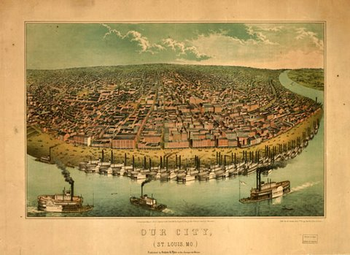
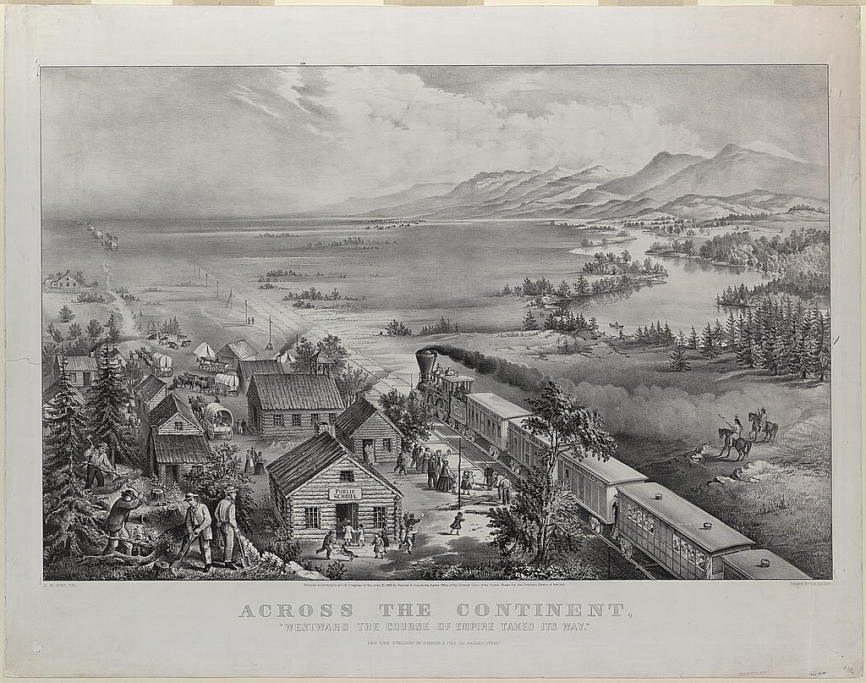
Stop 1: St. Louis, Missouri: Gateway to the West
St. Louis was first settled in the 1700s by French traders as a frontier town. The frontier was an area of wild, unexplored country. They chose this spot because it is near where the Mississippi and Missouri rivers come together.
The city is known as the Gateway to the West because pioneers, the first people to settle the West, began their journey in St. Louis.
Why do you think they chose to settle near rivers?
Notes:
Our City lithograph (c. 1850) image retrieved on 1/28/2012 from http://www.artesmagazine.com/2011/02/the-american-frontier-native-american-identity-and-western-expansionism-through-artists-eyes/
Across the Continent (Currier & Ives, 1868) image retrieved on 1/28/2012 from http://digitaldocsinabox.org/images/WestwardExpansion/WestwardExpansion.html

Slide 7
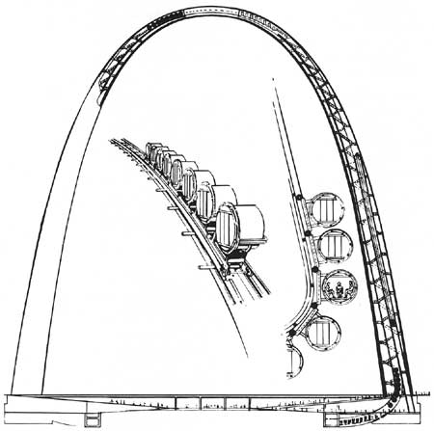
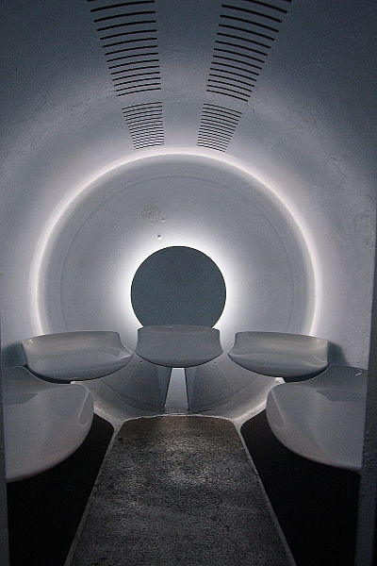
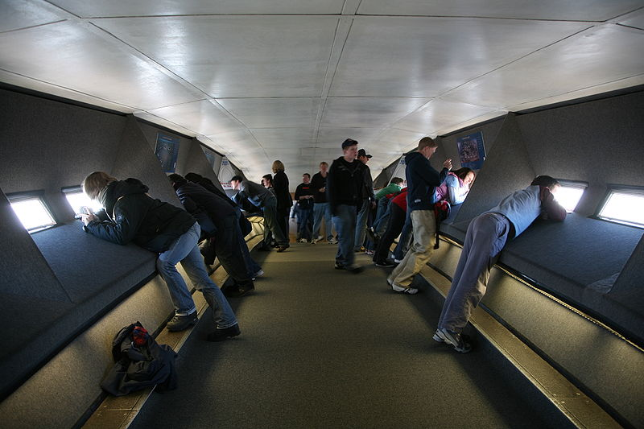
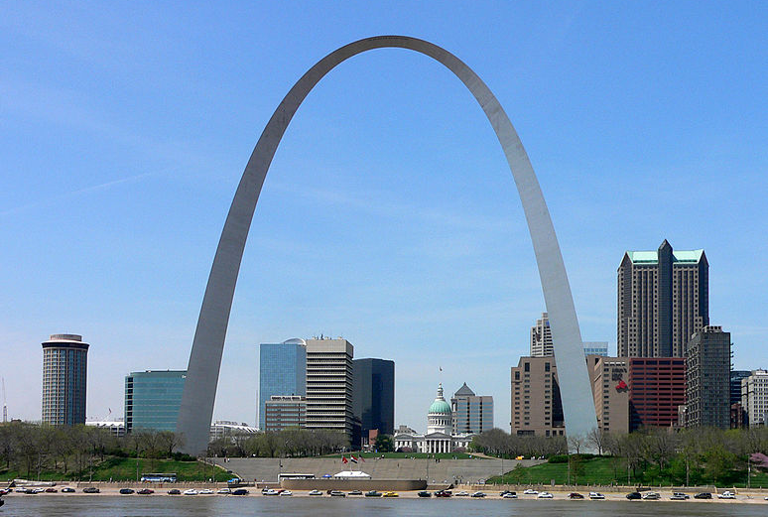
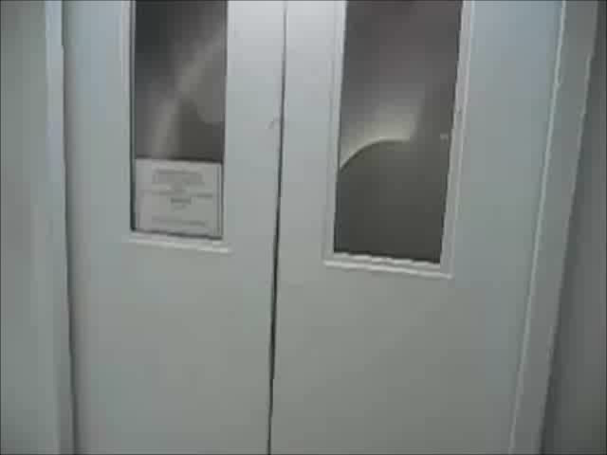
Stop 1: St. Louis, Missouri: Gateway to the West
The Gateway Arch was built in 1965 and is the tallest (630 feet) man-made monument in the United States. It was built to honor the pioneers who began their journey in St. Louis.
Gateway Arch Tram video (1:09)
Notes:
Gateway arch tram diagram retrieved on 1/28/2012 from http://www.nps.gov/history/history/online_books/jeff/adhi2-4b.htm
Observation deck image retrieved on 1/28/2012 from http://en.wikipedia.org/wiki/File:JNEM_Observation_deck.jpg
Tram interior image retrieved on 1/28/2012 from http://en.wikipedia.org/wiki/File:Gateway_Arch_tram_car.JPG
Gateway Arch image retrieved on 1/28/2012 from http://en.wikipedia.org/wiki/File:St_Louis_Gateway_Arch.jpg
Tram video retrieved on 1/28/2012 from http://www.youtube.com/watch?v=v_vdyzxgRb4 using SaveVid

Slide 8
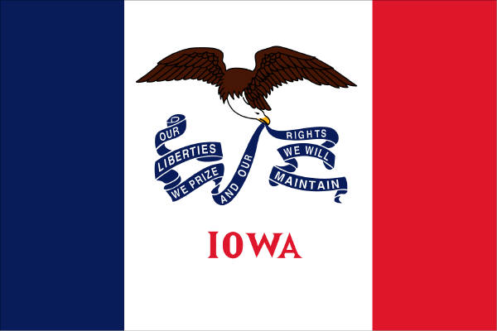
Welcome to Iowa!
State Date: December 28, 1846
Nickname: Hawkeye State
Motto: Our liberties we prize and our rights we will maintain
Capital: Des Moines
Flower: Wild Prairie Rose
Bird: Eastern Goldfinch
Tree: Oak
Song: The Song of Iowa

Slide 9
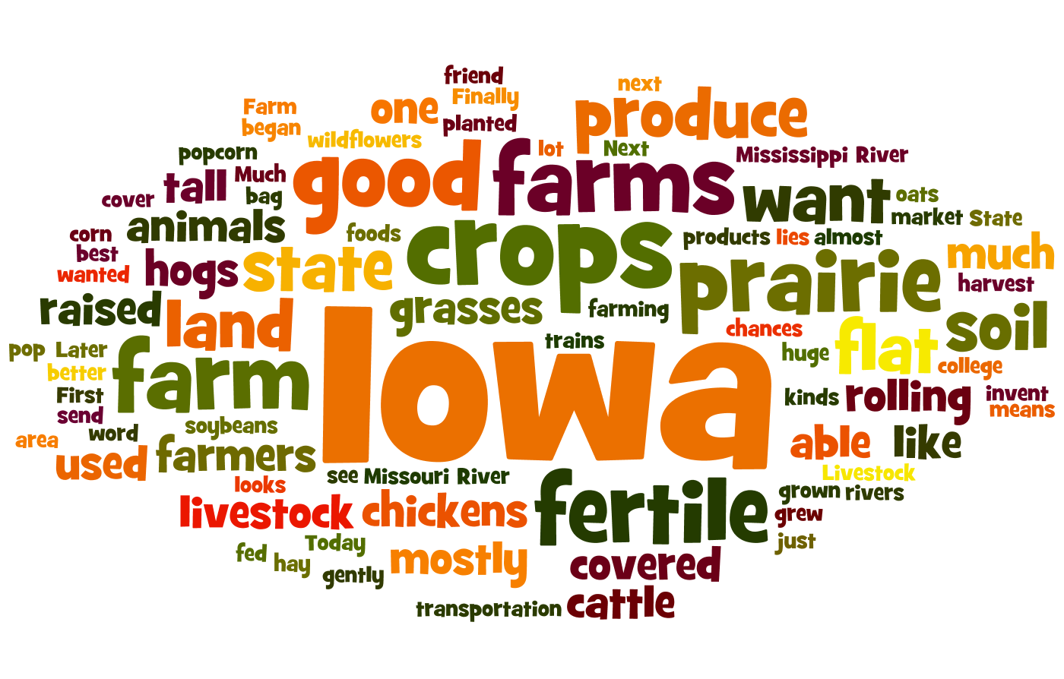
The next stop we will travel to is the Farm State of Iowa…
Notes:
This wordle has all the words we will read in the textbook about the stop. The words that are bigger are in the reading more times, the smallest words are only in the reading once.
What do you think we will learn about at our next stop?
http://www.wordle.net/show/wrdl/4747401/Farms%2C_Iowa

Slide 10
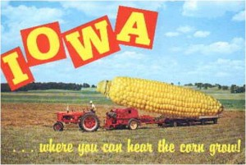
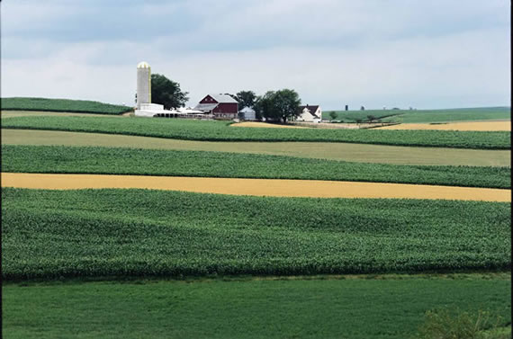
Stop 2: The Farm
State of Iowa
Iowa used to be prairie land, mostly flat and covered with tall grasses. Farmers planted in the fertile soil, which was able to produce good crops. Now, farms cover almost the entire state! Iowa is the largest producer of corn in the United States.
Some of the crops grown in Iowa feed livestock such as cows, pigs, and chickens. Others are in the foods that we eat. The corn crop can also be used to make paper, plastic, and ethanol fuel.
Notes:
“Strips of oats and hay are interspersed with strips of corn to save soil and improve water quality and wildlife habitat on this field in northeast Iowa.”
Iowa farm (1999) image retrieved 1/29/2012 from http://www.iptv.org/iowapathways/artifact_detail_large.cfm?aid=a_000089&oid=ob_000001
Postcard image retrieved 1/29/2012 from http://dailycaller.com/2012/01/02/ask-matt-labash-to-iowa-a-hate-letter-a-new-years-resolution-and-liberal-media-suppression/

Slide 11
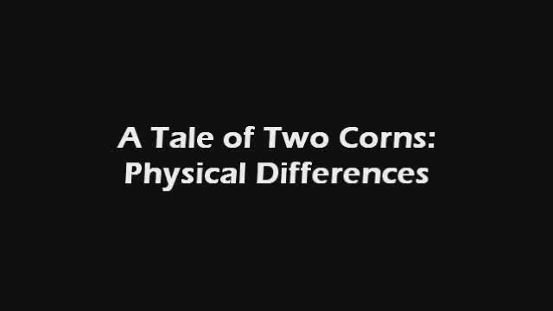

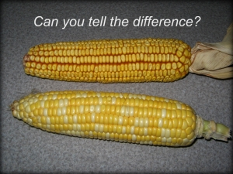
Stop 2: The Farm
State of Iowa
There are two different types of corn grown in the United States.
Field corn is about 99% of the corn planted each year.
Sweet corn is only about 1% of the corn grown in the United States.
Field Corn / Sweet Corn: Physical Differences video (2:02)
Field Corn / Sweet Corn: Different Uses video (1:43)
Notes:
Physical differences and different uses videos retrieved 1/30/2012 from http://www.ilcorn.org/grade-school/5-a-tale-of-two-corns/ using SaveVid
Field / Sweet corn image retrieved 1/30/2012 from http://www.ilcorn.org/grade-school/5-a-tale-of-two-corns/ using SaveVid

Slide 12
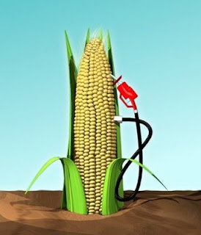
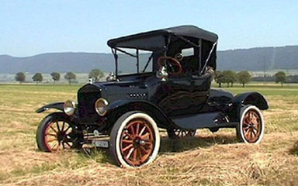
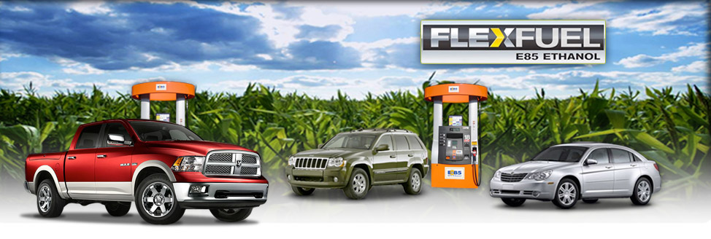
Stop 2: The Farm
State of Iowa
E10 fuel, 10% ethanol and 90% gasoline, can be used in almost all vehicles.
E85 fuel, 85% ethanol and 15% gasoline, can be used in special flex-fuel vehicles.
Corn can be used to make ethanol which is added to fuel for cars. Unlike oil, corn is a renewable resource. Fuel blended with ethanol helps keep our air clean. It burns cleaner, gives off less pollutants, and the plants grown to make ethanol use up carbon dioxide as they grow, which reduces global warming.
Ethanol has been used in cars since Henry Ford designed his 1908 Model T so it could run on pure ethanol!
Notes:
Corn fuel pump image retrieved 1/30/2012 from http://thehourlyg.blogspot.com/2011/02/department-of-so-not-surprisedethanol.html
Flex fuel vehicles image retrieved 1/30/2012 from http://www.springcjd.com/new/feature/flex_fuel?dpt=3
Model T image retrieved 1/30/2012 from http://e85club.org/economy.html

Slide 13
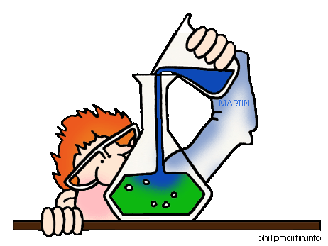
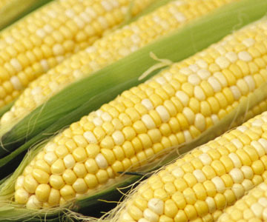
Stop 2: The Farm
State of Iowa
Fun Fact: One ear of corn has about 16 rows and 800 kernels. The number of rows will always be an even number.
Activity:
Make Biodegradable
Corn Plastic
Place 1 tablespoon of cornstarch in a paper cup.
Add two drops of corn oil to the cornstarch.
Add 1 tablespoon of water to the oil and cornstarch.
Stir the mixture.
What do you notice about your biodegradable corn plastic?
What do you think will happen if your plastic is heated?
Notes:
Teachers should microwave the liquid plastic in silicone candy molds to make hard plastic.
Corn image retrieved 1/30/2012 from http://www.hauserandhauserfarms.com/claudia's%20hints.html
Activity from AMAIZing Corn Activity Book by Iowa Corn Promotion Board, www.iowacorn.org

Slide 14
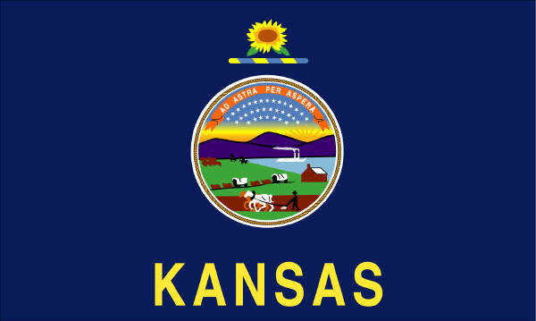
Welcome to Kansas!
State Date: January 29, 1861
Nickname: Sunflower State
Motto: To the stars through difficulties
Capital: Topeka
Flower: Native Sunflower
Bird: Western Meadowlark
Tree: Cottonwood
Song: Home on the Range

Slide 15
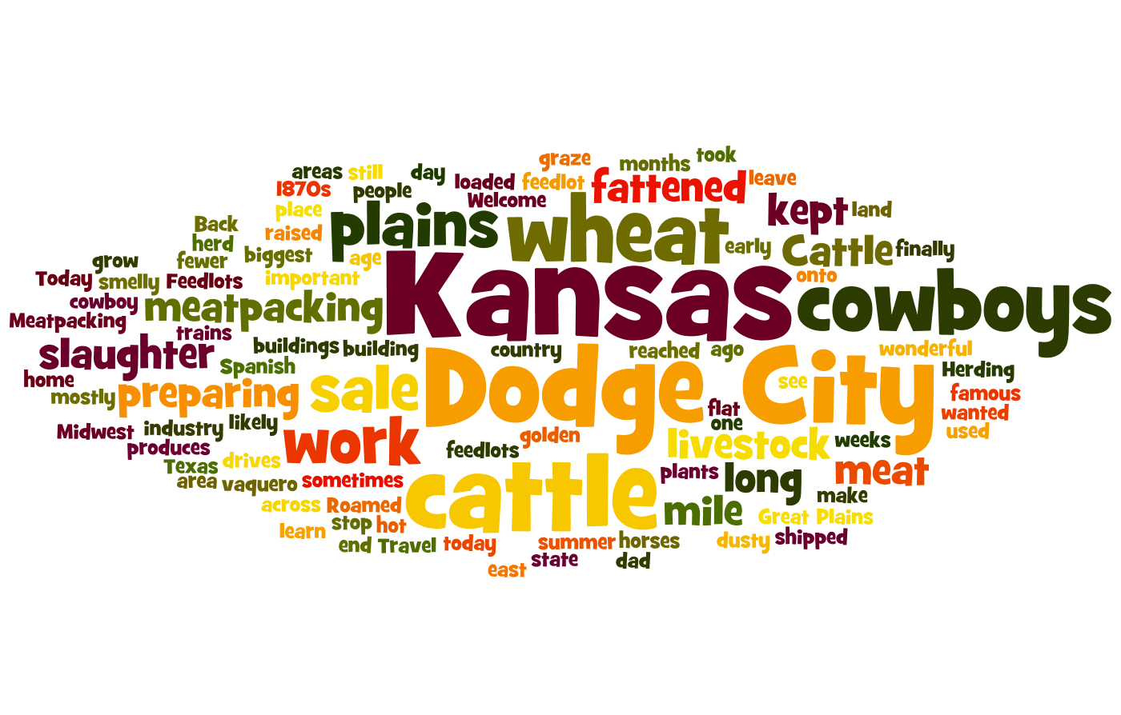
The next stop we will travel to is Dodge City, Kansas…
Notes:
This wordle has all the words we will read in the textbook about the stop. The words that are bigger are in the reading more times, the smallest words are only in the reading once.
What do you think we will learn about at our next stop?
http://www.wordle.net/show/wrdl/4747427/Dodge_City%2C_Kansas

Slide 16
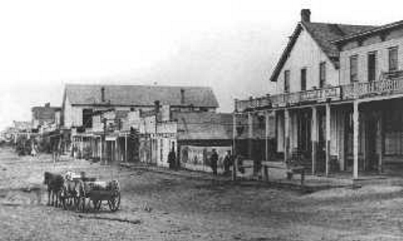
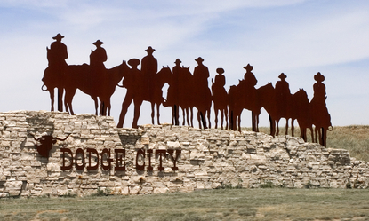

Stop 3: Dodge City, Kansas: Where the Cattle Once Roamed
In the 1870s, cowboys from Texas spent weeks or months herding thousands of cattle across the Great Plains to Dodge City in Kansas so that the cattle could be shipped east to be sold.
Today, cattle are raised on feedlots, areas where livestock are kept and fed. Preparing meat for sale is an important industry in the Midwest, and Dodge City has one of the biggest meatpacking plants in the country.
Cattle Drive (1933, no audio) video (0:48)
Notes:
Cattle Drive (1933) video retrieved 2/2/2012 from http://www.youtube.com/watch?v=8Quy1de7G74 using SaveVid
Dodge City (1876) image retrieved 2/2/2012 from http://www.outdoor.com/places/cities-and-towns/dodge-city-kansas/
Dodge City sign image retrieved 2/2/2012 from http://www.planetware.com/picture/dodge-city-us-ks131.htm

Slide 17
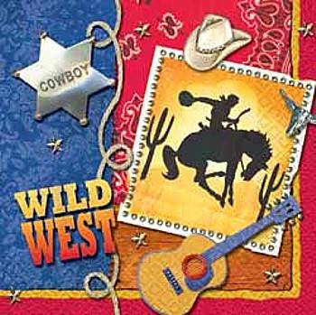

Stop 3: Dodge City, Kansas: Where the Cattle Once Roamed
While watching the slideshow, think about what the cowboys might have seen, heard, felt, smelled, and tasted during their time on the range.
Cowboy pictures slideshow (2:09)
Notes:
Cowboy pictures video retrieved 2/2/2012 from http://www.youtube.com/watch?v=fnOX45S8Ul8 using SaveVid
Wild West graphic retrieved 2/2/2012 from http://roanokelibrary.wikispaces.com/Internet+Activities

Slide 18
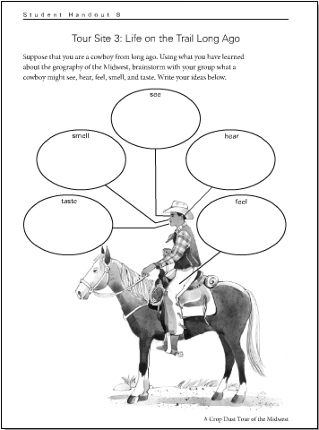
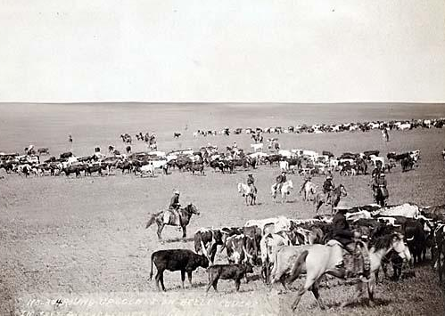
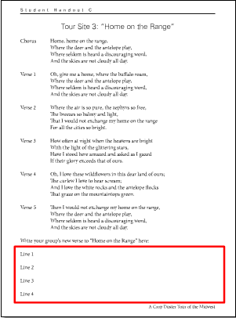
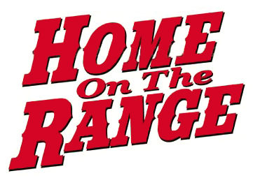
Activity: Cowboys singing “Home on the Range”
Imagine you are a cowboy from long ago. Discuss with your group what you would see, hear, feel, smell, and taste. Record your ideas on your cowboy handout.
Suppose you are driving cattle across the Great Plains. The trail is long, and you decide to sing a song with your fellow cowboys. Read the words on your handout and sing along.
Using the notes from your cowboy handout, write a new verse to the song “Home on the Range” with your group.
All Vocals 1:37
Instrumental with
Vocal Chorus 1:36
Notes:
Cattle drive (1887) image retrieved 2/2/2012 from http://www.old-picture.com/old-west/Cattle-Drive.htm
Vocal version of “Home on the Range” retrieved 2/2/2012 from http://sas-origin.OnstreamMedia.com/origin/tci/public/4_ROC/31 - Home on the Range_vocal.mp3
Instrumental version of “Home on the Range” retrieved 2/2/2012 from http://sas-origin.OnstreamMedia.com/origin/tci/public/4_ROC/32 - Home on the Range_instrumental, with vocal chorus.mp3
“Home on the Range” image retrieved 2/2/2012 from http://hayspost.com/wp-content/uploads/2011/04/range1.jpg

Slide 19
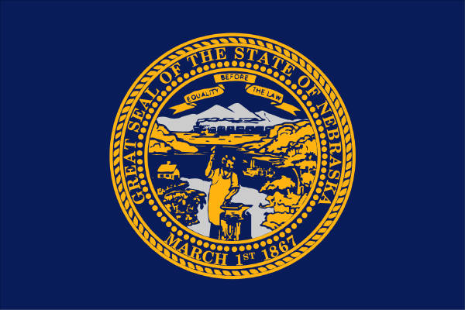
Welcome to Nebraska!
State Date: March 31, 1867
Nickname: Cornhusker State
Motto: Equality before the law
Capital: Lincoln
Flower: Goldenrod
Bird: Western Meadowlark
Tree: Cottonwood
Song: Beautiful Nebraska

Slide 20
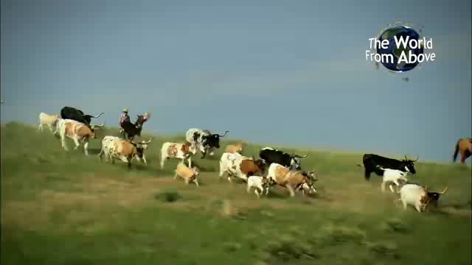
Nebraska…
Nebraska video (3:00)
Notes:
Nebraska video retrieved 9/22/2013 from http://www.youtube.com/watch?v=fD_iSqmypfg

Slide 21
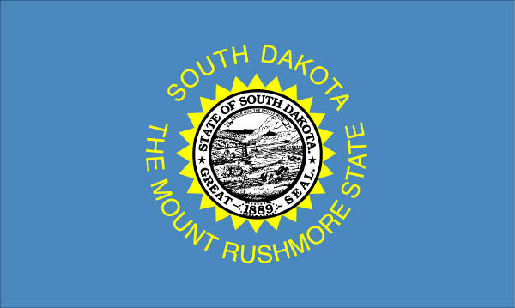
Welcome to South Dakota!
State Date: November 2, 1889
Nickname: Mount Rushmore State
Motto: Under God, the people rule
Capital: Pierre
Flower: American Pasqueflower
Bird: Ring-necked Pheasant
Tree: Black Hills Spruce
Song: Hail, South Dakota

Slide 22
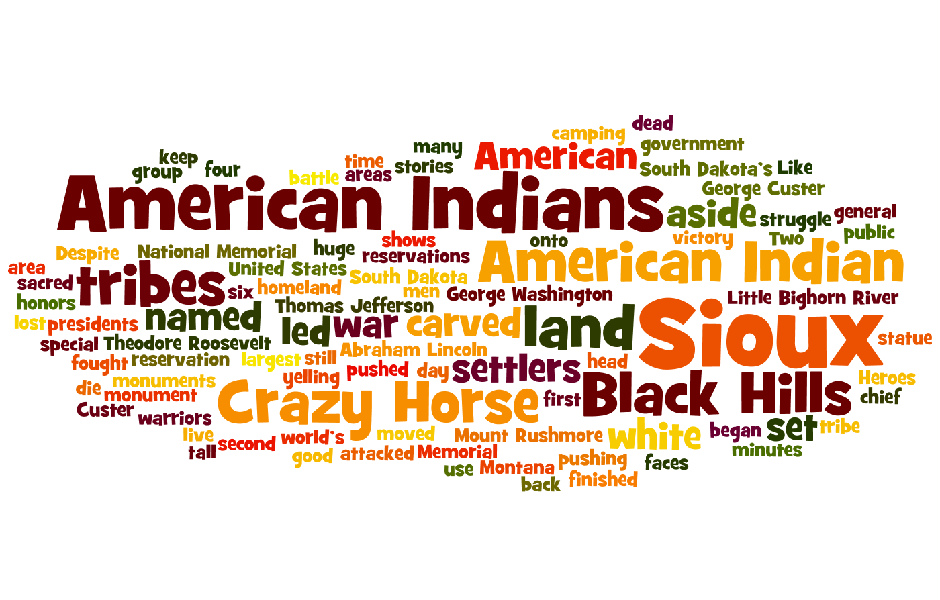
The next stop we will travel to is South Dakota…
Notes:
This wordle has all the words we will read in the textbook about the stop. The words that are bigger are in the reading more times, the smallest words are only in the reading once.
What do you think we will learn about at our next stop?
http://www.wordle.net/show/wrdl/4747450/Memorials%2C_South_Dakota

Slide 23
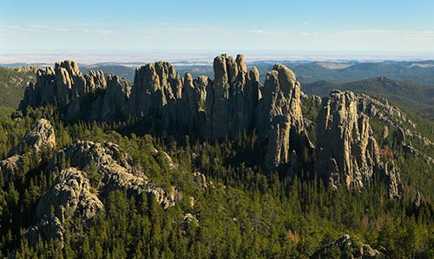
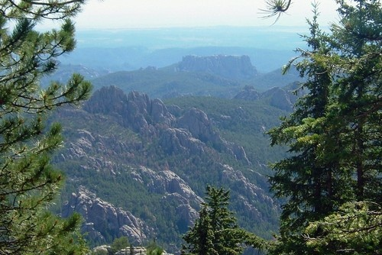
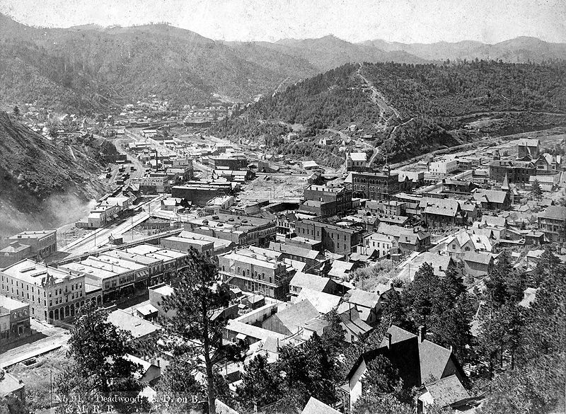
Stop 4: South Dakota’s
Heroes
The Black Hills, in the southwest part of South Dakota, are sacred to American Indian tribes such as the Sioux. When settlers moved into the area, tribes were pushed off their land. The American Indians fought to keep their land, but lost most of it. The Sioux were forced to live on reservations, special areas set aside for American Indians to live. There are still about 310 reservations in the United States.
Fun Fact: The city of Deadwood in the Black Hills began as a gold rush town. It later became a coal mining town.
Notes:
Black Hills is translation from Lakota Paha Sapa which refers to their dark appearance from a distance since they are covered by trees.
Custer State Park image retrieved 2/2/2012 from http://www.cityprofile.com/south-dakota/photos/12244-black-hills-custer-state-park.html
Black Hills (framed by trees) image retrieved 2/2/2012 from http://blackhillsportal.com/npps/story.cfm?id=2459
Deadwood (1890s) image retrieved 2/2/2012 from http://en.wikipedia.org/wiki/File:Deadwood_birdseye_circa_1890s.jpg

Slide 24
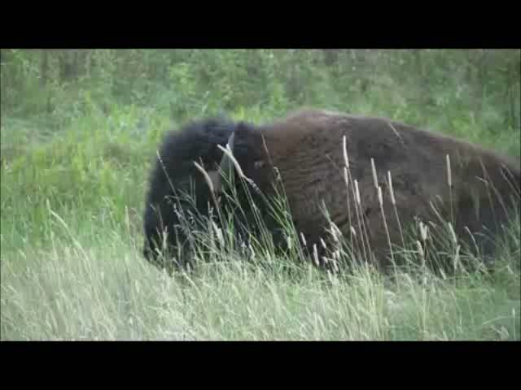
Stop 4: South Dakota’s Heroes
Black Hills video (2:50)
Notes:
Black Hills video retrieved 2/2/2012 from http://www.youtube.com/watch?v=qtljT_6yf-E using SaveVid

Slide 25
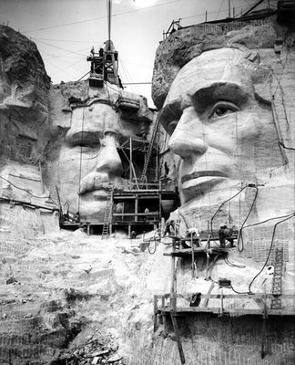
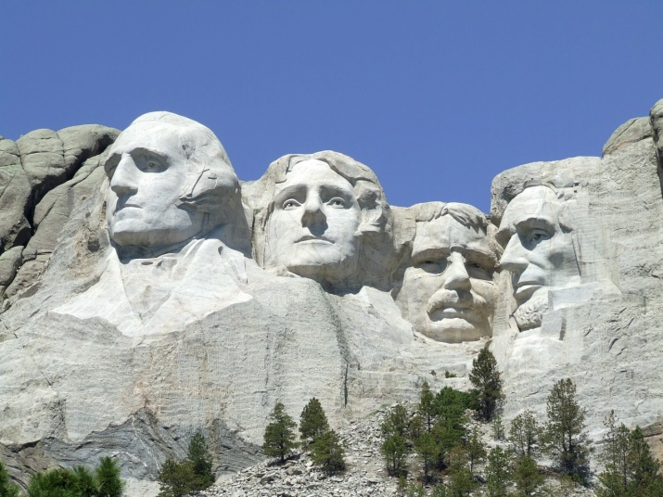
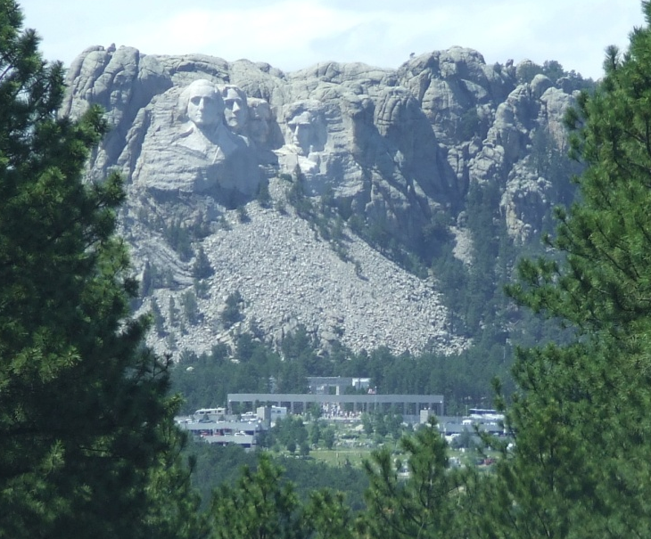
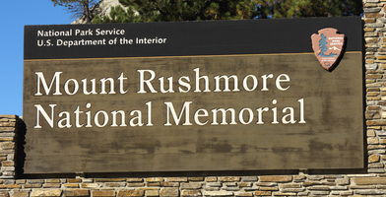
Stop 4: South Dakota’s
Heroes
Mount Rushmore is a monument carved into the granite of the Black Hills of South Dakota. Each head that is part of the monument is as tall as a six story building! The monument honors four American presidents: George Washington, Thomas Jefferson, Theodore Roosevelt, and Abraham Lincoln. Carving started in 1927 and finished in 1941.
Notes:
It was sculpted by the Danish-American Gutzon Borglum (born in the US to Mormon parents) and his son.
Carving image retrieved 2/2/2012 from http://www.brighthub.com/engineering/civil/articles/66778.aspx
Mount Rushmore images retrieved 2/2/2012 from http://www.nps.gov/moru/photosmultimedia/Mount-Rushmore-Now-Gallery.htm

Slide 26
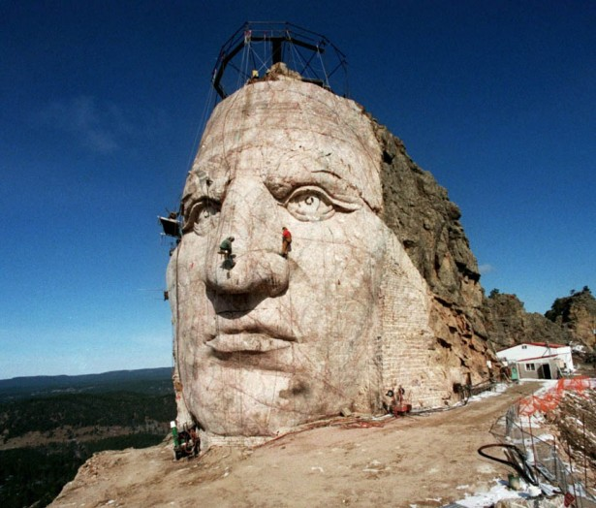
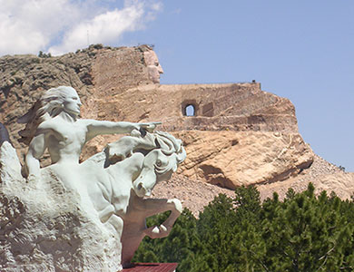
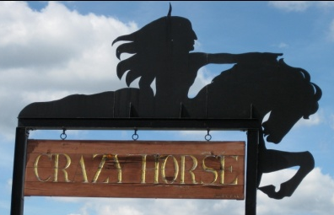


Stop 4: South Dakota’s
Heroes
Another monument in the Black Hills is the Crazy Horse Memorial. It was started in 1948 but is still not done. When completed, it will be the largest statue in the world! The monument is being built to honor Crazy Horse. He was an American Indian chief of the Sioux tribe. During the fight to keep their land, Crazy Horse led during a battle against General Custer at Little Bighorn in Montana. He and his Sioux warriors won the battle.
Notes:
TRY TO RETRIEVE http://www.caravan.com/flv/usa-mount-rushmore_crazy-horse.flv NEED STREAMING VIDEO GRABBER
Face completed in 1998.
Head will be 87 feet tall, bigger than heads on Mount Rushmore which are 60 feet tall.
Custer’s camp in the Black Hills (1874) image retrieved 2/2/2012 from http://www.buffalosoldier.net/Part%203.htm
Crazy Horse Memorial with statue image retrieved 2/2/2012 from http://aworldtourism.com/2011/12/the-amazing-crazy-horse-memorial/
Face image retrieved 2/2/2012 from http://indiancountrytodaymedianetwork.com/2011/01/05/did-you-know-crazy-horse-memorial-63-years-in-the-making-2647
Sketch (no photographs ever taken) of Crazy Horse image retrieved 2/2/2012 from http://en.wikipedia.org/wiki/Crazy_Horse

Slide 27

Welcome to North Dakota!
State Date: November 2, 1889
Nickname: Peace Garden State
Motto: Liberty and union, now and forever, one and inseparable
Capital: Bismarck
Flower: Wild Prairie Rose
Bird: Western Meadowlark
Tree: American Elm
Song: North Dakota Hymn

Slide 28

North Dakota…
North Dakota video (2:34)
Notes:
North Dakota video retrieved 9/22/2013 from http://www.youtube.com/watch?v=BQv_NrSg0Eo

Slide 29

Welcome to Michigan!
State Date: January 26, 1837
Nickname: Great Lakes State, Wolverine State
Motto: If you seek a pleasant peninsula, look about you.
Capital: Lansing
Flower: Apple Blossom
Bird: Robin
Tree: White Pine
Song: Michigan, My Michigan

Slide 30

The next stop we will travel to is Michigan’s Soo Locks…
Notes:
This wordle has all the words we will read in the textbook about the stop. The words that are bigger are in the reading more times, the smallest words are only in the reading once.
What do you think we will learn about at our next stop?
http://www.wordle.net/show/wrdl/4747463/Soo_Locks%2C_Michigan

Slide 31




Stop 5: Michigan’s Soo Locks: Linking the Great Lakes
The Soo Locks are the longest locks in the world. They raise or lower ships 21 feet between Lake Huron and Lake Superior. The Great Lakes are part of a water highway that goes from the Midwest all the way to the Atlantic Ocean. Many ships, small ones and large ones up to 1000 feet long, pass through the locks each day.
Notes:
Locks are closed January to March. No shipping on Great Lakes due to ice during that time. Locks are inspected and maintained then.
Brochure requested on 2/2/2012 from http://www.soolocks.com via email to sales@soolocks.com
Lock animated GIF retrieved 1/28/2012 from http://huron.lre.usace.army.mil/SOO/alock.html
Soo Locks from the air image retrieved 1/28/2012 from http://www.thecanadianencyclopedia.com/articles/sault-ste-marie
Soo Locks close-up image retrieved 1/28/2012 from http://www.superiortrails.com/soo-locks.html
Soo Locks with boat image retrieved 1/28/2012 from http://www.michigan.org/city/Default.aspx?city=G3527

Slide 32

Stop 5: Michigan’s Soo Locks: Linking the Great Lakes
It takes about 20 to 25 minutes for a ship to pass through the lock.
Ship passing through one of the Soo Locks video (3:52)
Notes:
Soo locks video retrieved 2/2/2012 from http://www.youtube.com/watch?v=ow9DDqj-Hio via Savevid

Slide 33

The next stop we will travel to is Detroit, Michigan…
Notes:
This wordle has all the words we will read in the textbook about the stop. The words that are bigger are in the reading more times, the smallest words are only in the reading once.
What do you think we will learn about at our next stop?
http://www.wordle.net/show/wrdl/4747472/Ford%2C_Detroit%2C_Michigan

Slide 34


Stop 6: Detroit, Michigan: America’s Motor City
Henry Ford wanted to build cars that most people could afford. In 1908, he started a factory in Detroit, Michigan. Instead of building one car at a time like other automobile makers, he installed a moving assembly line where each worker did one task again and again. His assembly line made cars cheaper and faster than other companies could. He was very successful and other car makers came to Detroit, which became known as Motor City or Motown.
Model T video (4:07)
Notes:
Model T video retrieved 2/2/2012 from http://www.youtube.com/watch?v=qRuCLKFDpiE via Savevid
Ford assembly line image retrieved 2/3/2012 from http://www.autolife.umd.umich.edu/Labor/L_Overview/Ford_Assembly_Lines.htm

Slide 35


Stop 6: Detroit
The Ford Rouge Center in Dearborn, Michigan is on 600 acres of land and has 93 buildings, its own docks, 100 miles of railroad track, its own electricity plant, and almost 100 buildings. Some of the factories have recently been renovated or rebuilt, including the truck factory which has a vegetation-covered roof and rainwater reclamation system.
Ford Rouge Center video (4:37)
Fun Fact: Only Ford vehicles can park in the employee parking lot at the Dearborn truck factory.
Notes:
History of the Rouge video clip retrieved 2/21/2012 from http://www.youtube.com/watch?v=CohboThGO-o
Reinventing the Rouge video retrieved 2/21/2012 from http://www.youtube.com/watch?v=fax-JSIv8O4

Slide 36


Activity: Model T
Assembly Line Part A
Suppose you are a carmaker in the early 1900s. Each one of the cars you make is special. No two are exactly alike.
Work with your group to design and draw a car with:
all the features that make a car work (steering wheel, tires, and so on)
attractive wheel covers
an interesting hood ornament
a paint job that uses two colors
interesting headlamps (lights)
any other features you think customers would like
Answer the questions in Part A of your Assembly Line handout.
Notes:
1905 De Dietrich image retrieved 2/3/2012 from http://www.anythingaboutcars.com/early-1900s-cars.html

Slide 37


Activity: Model T
Assembly Line Part B
Now suppose you are a worker on Ford’s assembly line in the 1920s. Each one of the cars you make is exactly alike.
Create a line of desks and sit with your group. Each worker will add one part of the Model T. When you have added your part, pass the car to the next worker.
  1: Front tires 2: Rear tires
  3: Headlamps 4: Steering wheel
  5: Windshield 6: Rear door
Each assembly line will have 25 Model T cars to complete. You will have 5 minutes.
Count how many cars your group completed. Answer the questions in Part B of your handout.

Slide 38

Welcome to Ohio!
State Date: March 1, 1803
Nickname: Buckeye State
Motto: With God, all things are possible
Capital: Columbus
Flower: Scarlet Carnation
Bird: Cardinal
Tree: Buckeye
Song: Beautiful Ohio

Slide 39


Ohio…
Cleveland, OH video (1:56)
Ohio video (0:59)
Notes:
Ohio video retrieved 9/22/2013 from http://www.youtube.com/watch?v=j2int_Nuw_o
Cleveland video retrieved 9/22/2013 from http://www.youtube.com/watch?v=YeDTpvPBVhg

Slide 40

Welcome to Indiana!
State Date: December 11, 1816
Nickname: Hoosier State
Motto: The Crossroads of America
Capital: Indianapolis
Flower: Peony
Bird: Cardinal
Tree: Tulip Poplar
Song: On the Banks of the Wabash

Slide 41

Indiana…
Indianapolis video (2:29)
Notes:
Indiana video retrieved 9/22/2013 from http://www.youtube.com/watch?v=DkMgvdHQ4WU

Slide 42

Welcome to Illinois!
State Date: December 3, 1818
Nickname: Prairie State
Motto: State sovereignty, national union
Capital: Springfield
Flower: Native Violet
Bird: Cardinal
Tree: White Oak
Song: Illinois

Slide 43

The next stop we will travel to is O’Hare International Airport…
Notes:
This wordle has all the words we will read in the textbook about the stop. The words that are bigger are in the reading more times, the smallest words are only in the reading once.
What do you think we will learn about at our next stop?
http://www.wordle.net/show/wrdl/4747480/O%27Hare%2C_Chicago%2C_Illinois

Slide 44


Stop 7: O’Hare Airport: The Midwest’s Transportation Hub
Even before O’Hare
International Airport
was built, Chicago
was a transportation
hub, a center for
moving goods and
people, with trains
leaving every day
bringing goods
between small
farming towns and
the big cities. Today,
more people and goods are moved into and out of Chicago than any other city by all different forms of transportation – by air, by ground, and by water.
Notes:
United Airlines USA route map showing Chicago hub
Airplane image retrieved 2/3/2012 from http://www.free-vectorart.com/airplane-clip-art-free/

Slide 45



Stop 7: O’Hare Airport: The Midwest’s Transportation Hub
O’Hare International Airport in Chicago, Illinois is one of the busiest in the country.
O’Hare Airport video (2:43)
Notes:
O’Hare video retrieved 2/23/2012 from http://www.youtube.com/watch?v=Pd9flg7dmPM
Map retrieved 2/3/2012 from http://www.chicagotraveler.com/chicago-ohare-airport-map.htm
Aerial image retrieved 2/3/2012 from http://www.visitingdc.com/airports/ohare-airport-code.asp

Slide 46


Stop 7: O’Hare Airport: The Midwest’s Transportation Hub
O’Hare was not always an airport. It was built in 1942 as a manufacturing plant for Douglas C-54 airplanes during World War II. As Chicago’s Midway Airport became too busy, the city chose the site to become the O’Hare International Airport. In 1965, it was the world’s busiest airport. Twenty million people passed through O’Hare in that one year, more than passed through Ellis Island in its entire existence!
Notes:
O’Hare (1963) image retrieved 2/3/2012 from http://www.windycitystockphotos.com/vintage.html
Douglas C-54 airplane image retrieved 2/3/2012 from http://en.wikipedia.org/wiki/C-54_Skymaster

Slide 47

The next stop we will travel to is Chicago’s Wrigley Field…
Notes:
This wordle has all the words we will read in the textbook about the stop. The words that are bigger are in the reading more times, the smallest words are only in the reading once.
What do you think we will learn about at our next stop?
http://www.wordle.net/show/wrdl/4747491/Wrigley_Field%2C_Chicago%2C_Illinois

Slide 48





Stop 8: Chicago’s
Wrigley Field
Wrigley Field opened in 1914. It is the second oldest major league baseball park in the country. Boston’s Fenway Park, built in 1912, is the oldest!
The centerfield scoreboard was built in 1937 and is still manually operated. No batted ball has ever hit the scoreboard!
Wrigley Field has a tradition of flying a white flag with a blue W when the Cubs win a game, and a blue flag with a white L when they lose.

Slide 49



Stop 8: Chicago’s
Wrigley Field
One of the most famous things to happen at Wrigley Field was Babe Ruth’s “called shot” during Game 3 of the 1932 New York Yankees vs. Chicago Cubs World Series.
Babe Ruth’s “Called Shot” video (2:02)
Notes:
Called Shot (GSL) video retrieved 2/23/2012 from http://www.youtube.com/watch?v=IT3_ff5nqkI

Slide 50



Stop 8: Chicago’s
Wrigley Field
“Take Me Out To The Ballgame” is one of the most easily recognized songs (after “Happy Birthday” and “The Star Spangled Banner”) in the United States. The first recorded version was sung by Edward Meeker in 1908.
Harry Caray, who was a longtime announcer for the Cubs, always sang “Take Me Out To The Ballgame” during the seventh inning stretch at Wrigley Field.
“Take Me Out To The Ballgame” (1908) video (2:11)
“Take Me Out To The Ballgame” (Caray) video (1:15)
Fun Fact: Harry Caray was born in 1914, the same year that Wrigley Field opened.
Notes:
Edward Meeker singing Take Me Out To The Ballgame (1908) video retrieved 2/23/2012 from http://www.youtube.com/watch?v=q4-gsdLSSQ0
Harry Caray singing Take Me Out To The Ballgame (at Wrigley Field) video retrieved 2/23/2012 from http://www.youtube.com/watch?v=OBvKBvhTbxE
Some info retrieved 2/23/2012 from http://lcweb2.loc.gov/diglib/ihas/loc.natlib.ihas.200153239/default.html

Slide 51

Welcome to Wisconsin!
State Date: May 29, 1848
Nickname: America’s Dairyland
Motto: Forward
Capital: Madison
Flower: Wood Violet
Bird: Robin
Tree: Sugar Maple
Song: On, Wisconsin!

Slide 52

Wisconsin…
Wisconsin Dairyland video (5:30)
Notes:
Wisconsin Dairyland video retrieved 9/22/2013 from http://www.youtube.com/watch?v=XNupYSyUiIw

Slide 53

Welcome to Minnesota!
State Date: May 5, 1858
Nickname: North Star State, Gopher State
Motto: The star of the north
Capital: St. Paul
Flower: Pink & White Lady’s Slipper
Bird: Common Loon
Tree: Red Pine
Song: Hail! Minnesota

Slide 54

The last stop we will travel to is Minnesota’s Mall of America…
Notes:
This wordle has all the words we will read in the textbook about the stop. The words that are bigger are in the reading more times, the smallest words are only in the reading once.
What do you think we will learn about at our next stop?
http://www.wordle.net/show/wrdl/4747515/Mall_of_America%2C_Minnesota

Slide 55




Stop 9: Minnesota’s
Mall of America
The Mall of America (MoA) was built in Minneapolis, Minnesota in 1992 where the Metropolitan Stadium used to be. The Minnesota Vikings and Twins played at Met Stadium until 1982. The mall has a plaque in the exact location where home plate was. There is also a seat from the stadium bolted to the wall in Nickelodeon Universe in the exact location that hall-of-famer Harmon Killebrew hit a 520 foot home run to on June 3, 1967.
Notes:
Mall maps requested on 1/27/2012 via online form at www.mallofamerica.com
Home plate and chair images retrieved 2/24/2012 from http://en.wikipedia.org/wiki/Mall_of_america

Slide 56



Stop 9:
MoA
The Mall of America is the biggest mall in the USA!
520+ stores
86 hours total to spend just 10 minutes in each store
1.2 million-gallon aquarium
25 rides & attractions, and 30,000+ plants & trees, in Nickelodeon Universe
170,000+ Legos have been lost in the LEGO play area
40 million visitors annually which is more than the combined populations of North Dakota, South Dakota, Iowa... and Canada
Mall of America video (1:30)
Notes:
Video tour retrieved 2/24/2012 from http://www.youtube.com/watch?v=xSJwmpeatP8&list=UUM31kmbXJnO8xKPue2_Ebcg&index=35&feature=plcp
Facts retrieved 2/24/2012 from http://www.mallofamerica.com/about/moa/facts
MoA image retrieved 2/24/2012 from http://www.mallofamerica.com/about/pressroom/gallery

Slide 57






Stop 9:
MoA
What could fit inside the Mall of America?
7 Yankee Stadiums
32 Boeing 747 airplanes
258 Statues of Liberty
If Mount Rushmore was divided into individual monuments, a president could fit in each of the Mall’s four courts
Notes:
Facts retrieved 2/24/2012 from http://www.mallofamerica.com/about/moa/facts

Slide 58
How did the Midwest get the two very different nicknames America’s Breadbasket and America’s Heartland?
America’s Breadbasket
Farmers in the Midwest grow a lot of the wheat we use to make bread
Kansas is the state which grows the most wheat
North Dakota, South Dakota, Minnesota, Ohio, Illinois, and Nebraska also grow a large wheat crop
America’s Heartland
The Midwest lies at the heart, or center, of the United States
It is where pioneers began their journeys west
American Indians fought bravely to defend their lands in the Midwest
It is a center for both farming and industry

